Slide 1

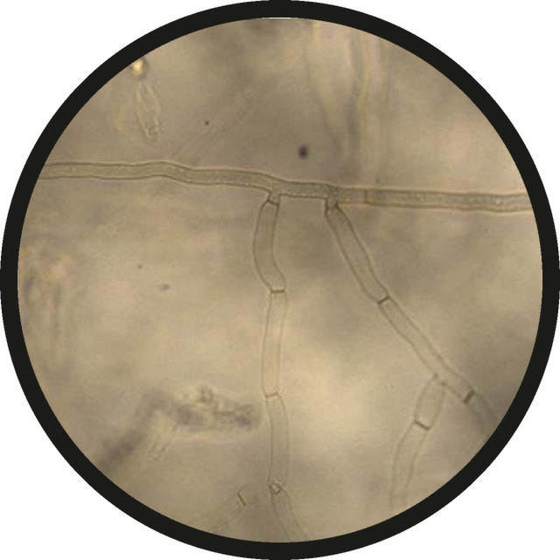



Fungal hypha: same width along its whole length.
same width here
and here
Micrograph: Gondal, Rauf and Naz 2019, Scientific Reports, CC BY 4.0 (cropped)

Slide 2



Parallel walls, often branching.
parallel walls
a branch
Micrograph: Gondal, Rauf and Naz 2019, Scientific Reports, CC BY 4.0 (cropped)

Slide 3

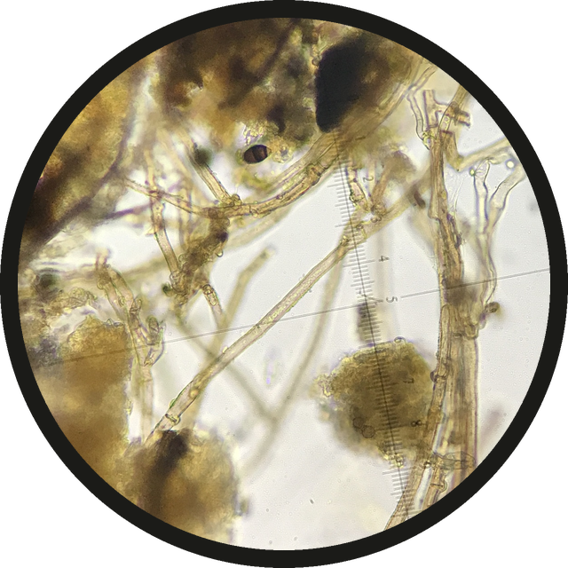


Debris: irregular edges, changing width.
a hypha, for comparison
debris
Photo: Matthew Rozanoff / iNaturalist, CC BY 4.0 (cropped)

Slide 4

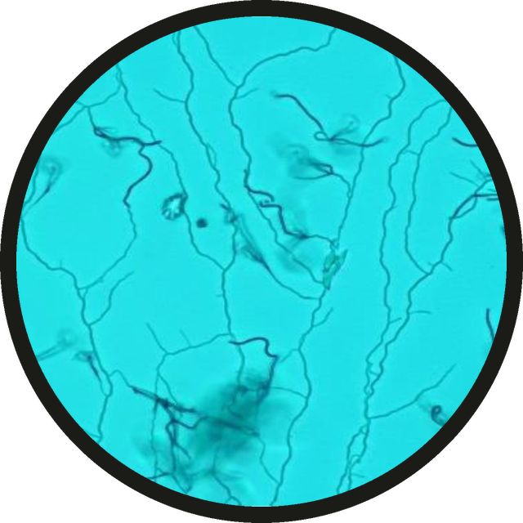

Actinomycetes: much thinner threads.
thin, branching threads
Micrograph: Du et al. 2025, PLOS ONE, CC BY 4.0 (cropped)

