Slide 1

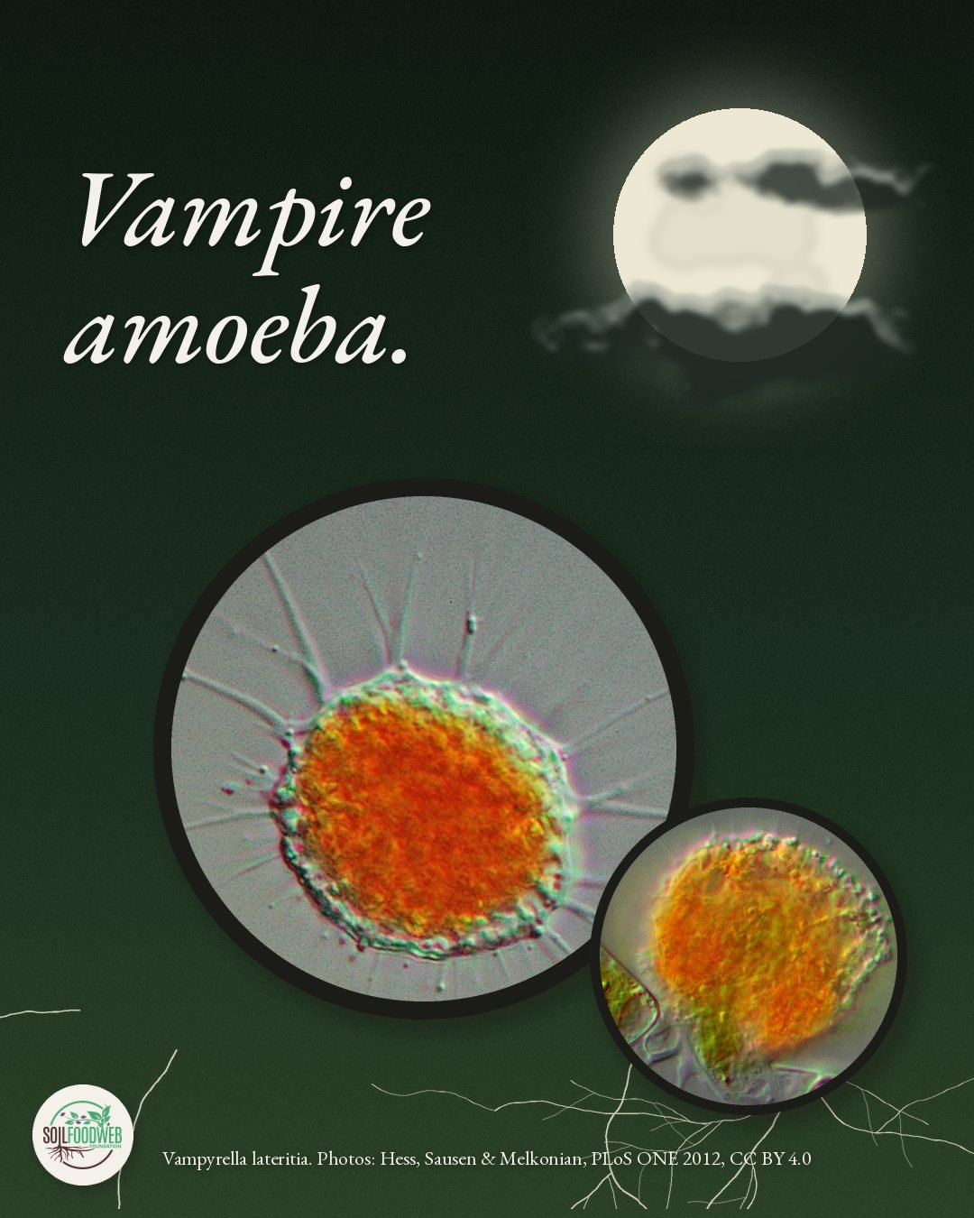

Slide 2

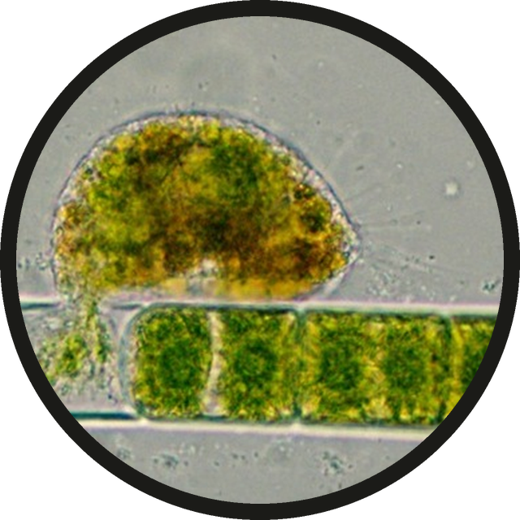

It latches onto an algal cell and drills through the wall.
a vampire amoeba on a strand of algae
Photos: Hess, Sausen and Melkonian 2012, PLoS ONE, CC BY 4.0 (cropped)

Slide 3

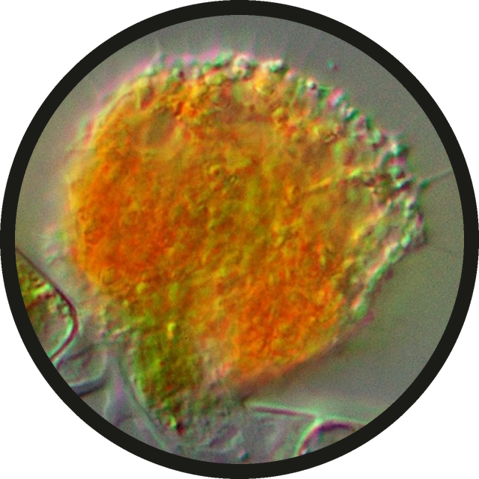
Then it drains what is inside.
draining an algal cell
Photos: Hess, Sausen and Melkonian 2012, PLoS ONE, CC BY 4.0 (cropped)

Slide 4

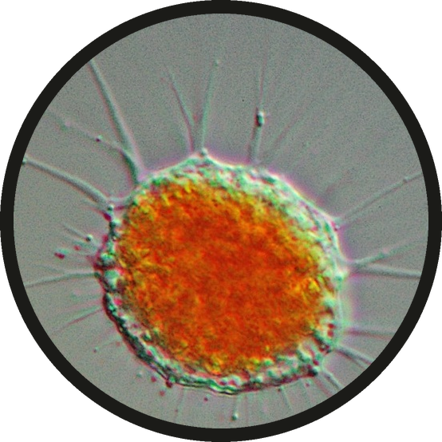
Our mentor Wes Sander wrote all about them on our blog. Link in bio.
Vampyrella lateritia
Photos: Hess, Sausen and Melkonian 2012, PLoS ONE, CC BY 4.0 (cropped)

