Slide 1



FALL ENROLLMENT SPECIAL
Last day
Foundation Courses + Compost Intensive.
The special ends today.

Slide 2


4 Foundation Courses
Self-paced, 63 lectures and about 150 hours of study.
A seat in a 2027 Compost Intensive cohort
Ten weeks online, with a 90-minute live session with a mentor every week.
Hundreds of hours of webinars
Our legacy webinar archive, recorded live with Dr. Elaine Ingham.

Slide 3

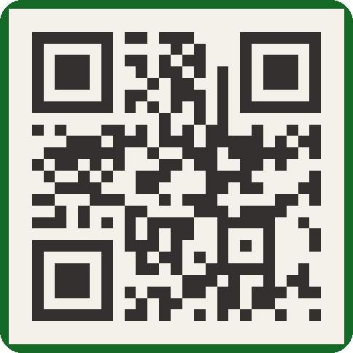
Foundation Courses + Compost Intensive
Fall Enrollment Special
Ends today.

