Slide 1

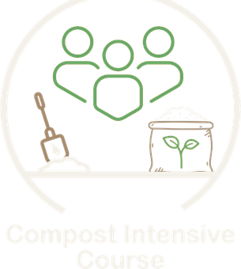

The Compost Intensive Course
No prerequisites. All are welcome.

Slide 2


Ten weeks, online
10
90
weeks, online
minutes live with a mentor every week
2
3
compost piles you build where you live
2027 cohorts: January, May or August

Slide 3

80%
More than 80% of the people who took our pilot version of this course walked away with successful thermophilic piles that achieved BioComplete™ biological potency.

Slide 4

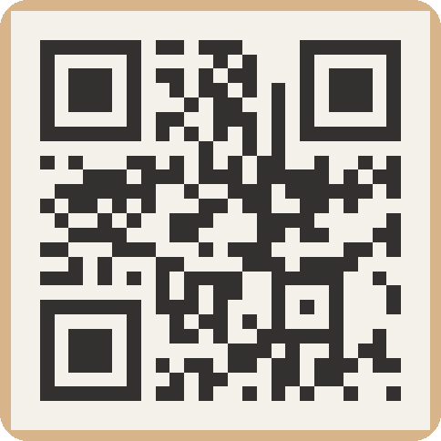
Foundation Courses + Compost Intensive
Fall Enrollment Special
Until 2 December.

