Slide 1




Look, feel, smell, structure, maturity
In the Compost Intensive Course you assess compost quality using practical field observations.

Slide 2


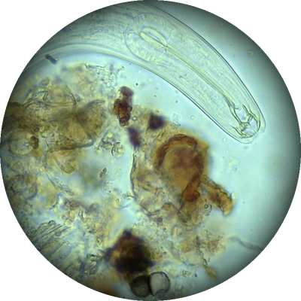
Foundation Course 4: Microscopy
Learn to use a compound microscope to identify and quantify bacteria, fungi, protozoa and nematodes.
Nematode, 40x. Photo: Keisha Wheeler

Slide 3
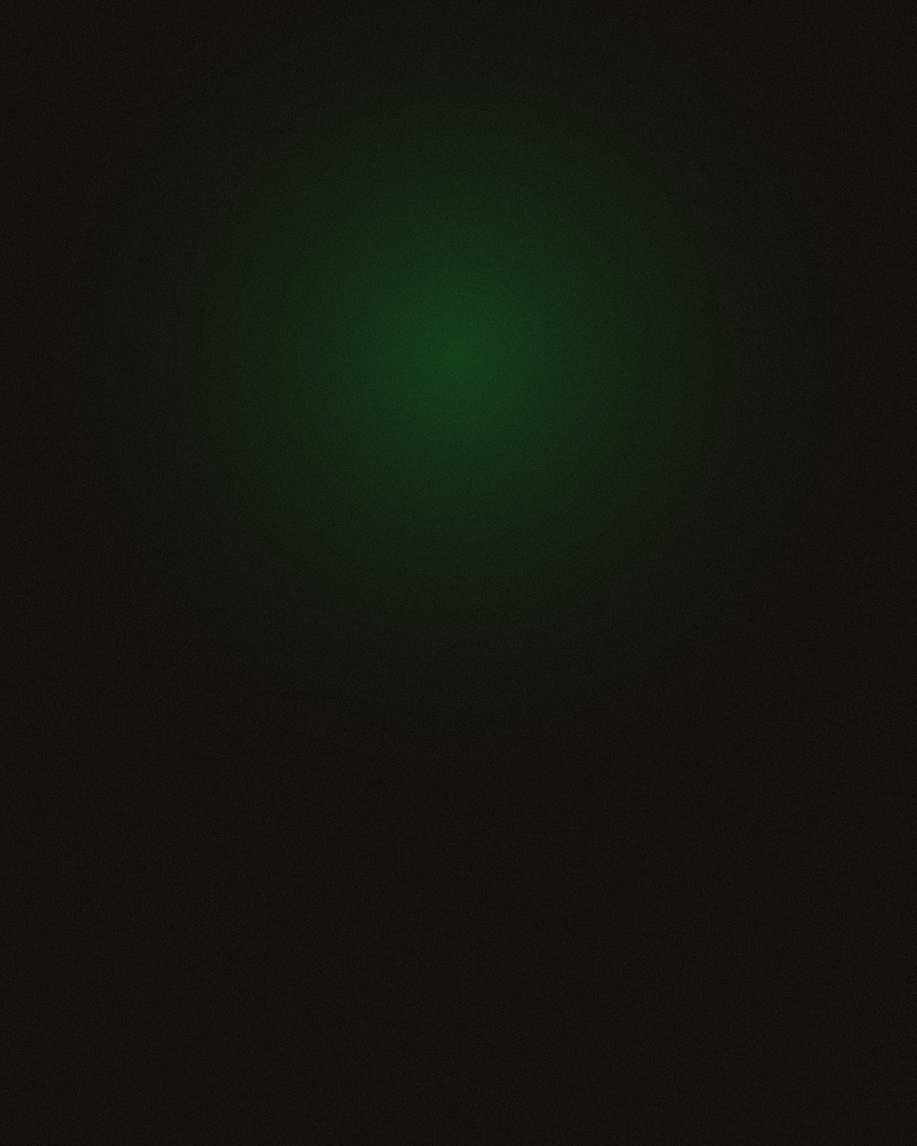
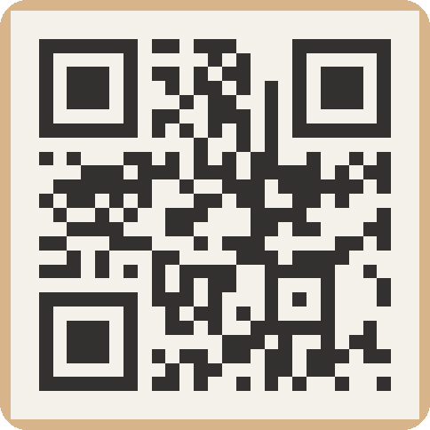
Foundation Courses + Compost Intensive
Fall Enrollment Special
Until 2 December.

