Slide 1



One week left
Start the Foundation Courses today.
Pick one 2027 Compost Intensive cohort.
11 Jan
to 26 Mar
D
J
N
F
30 Aug
to 7 Nov
O
M
2027
S
A
A
M
J
J
10 May
to 25 Jul

Slide 2

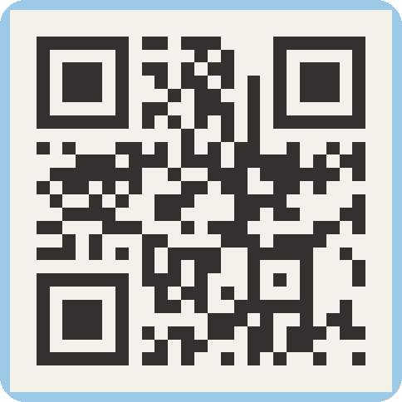
Foundation Courses + Compost Intensive
Fall Enrollment Special
Until 2 December.

