Slide 1
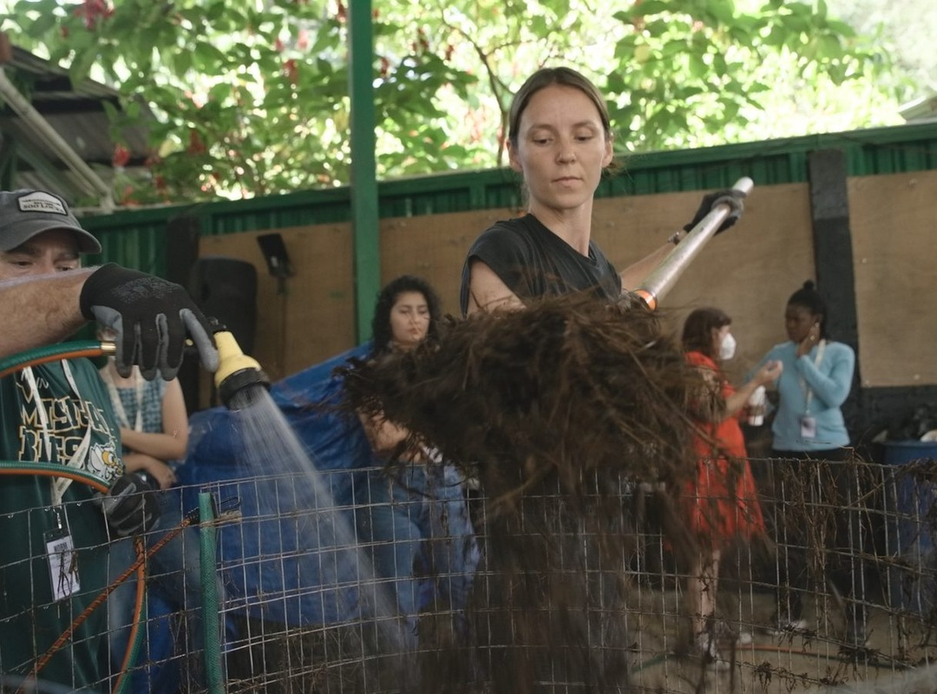


Several batches, different recipes.
Costa Rica, 18 to 29 January 2027

Slide 2
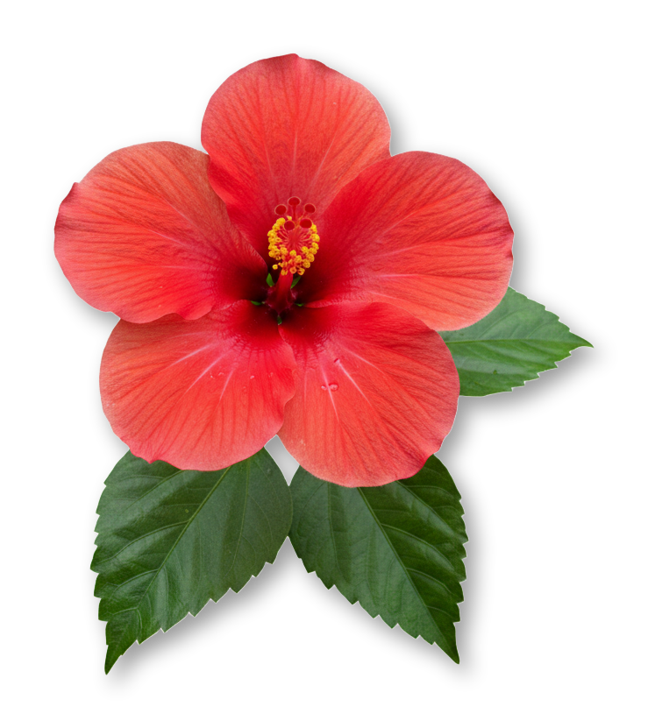
Every pile behaves differently.

Slide 3
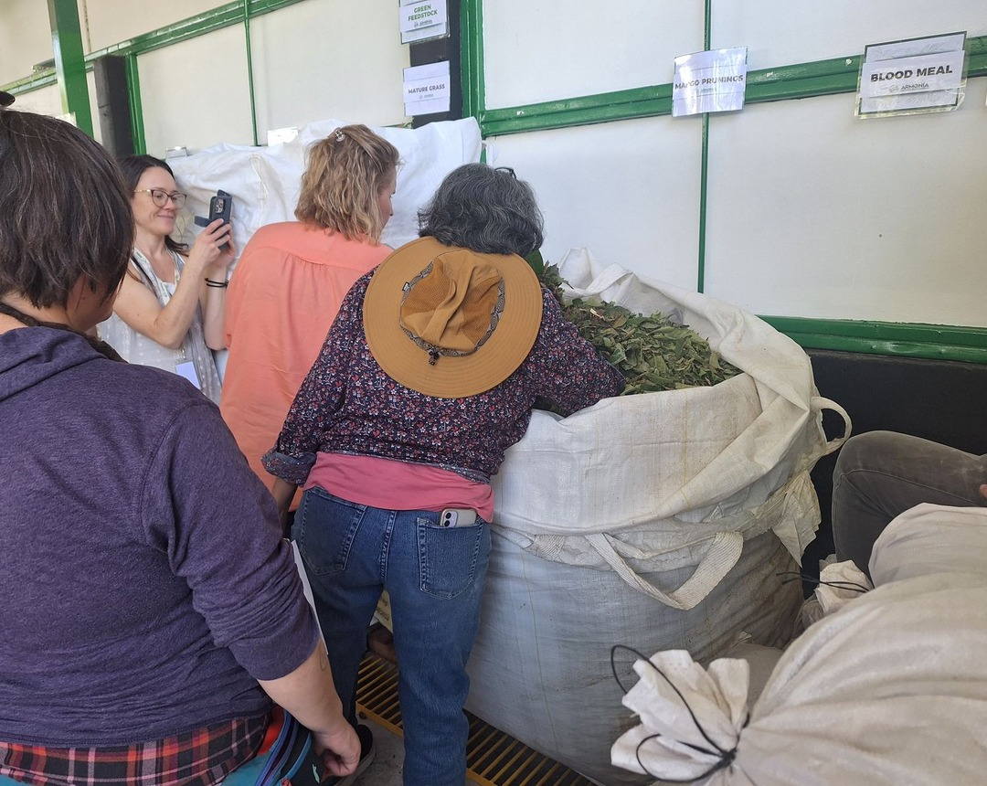


Students build several batches at once.
Each team picks its feedstocks and works out its own recipe.

Slide 4
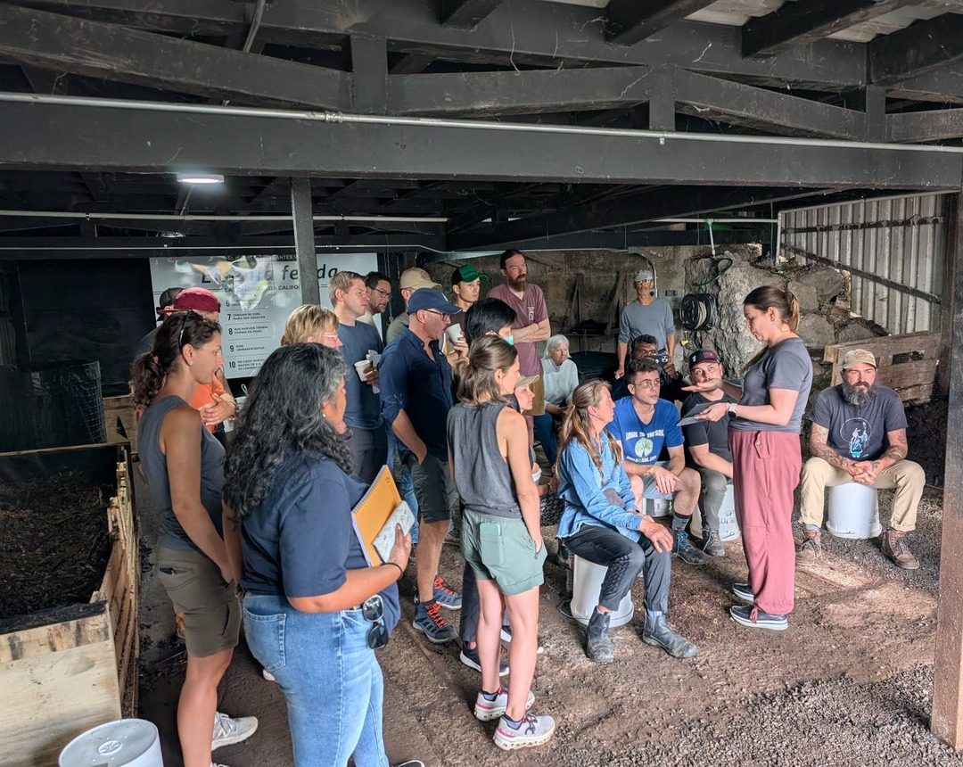
Then you read each pile and adjust it.
With a mentor beside you.

Slide 5

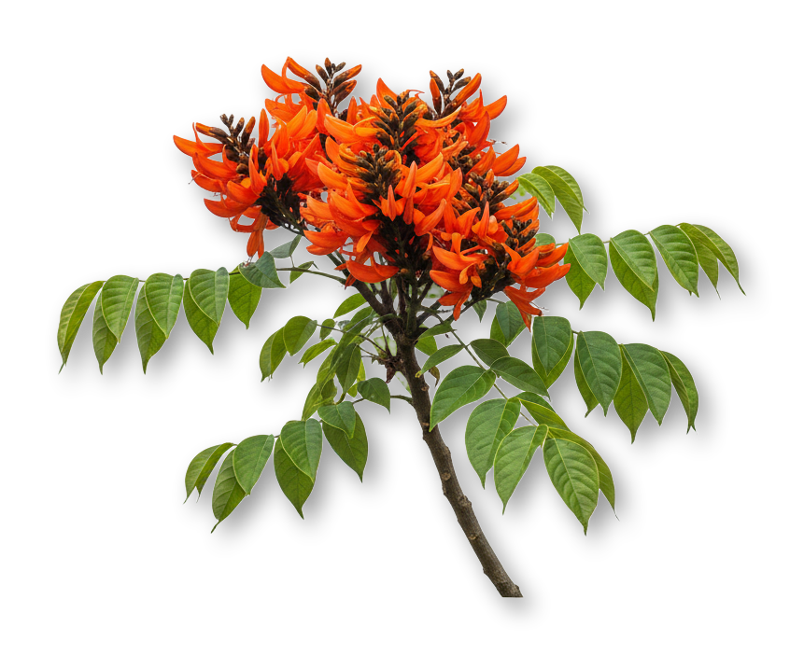
18 to 29 January 2027
Accelerator Workshop at Armonía Agricultura Orgánica, near San José, Costa Rica
Register, link in bio

