Slide 1

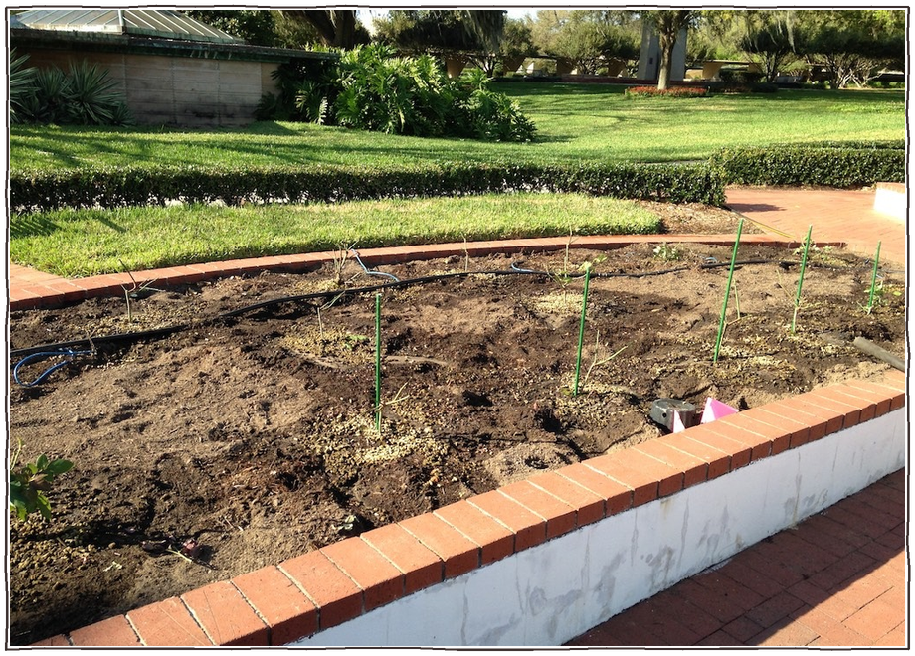

Bare soil in winter is soil you're losing.
Photo: Malcolm Manners, CC BY 2.0

Slide 2

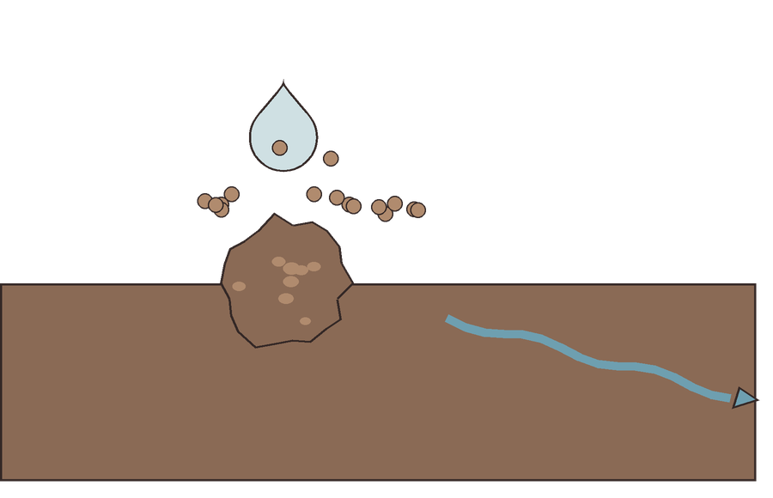


Rain hits bare soil hard, breaks aggregates apart and washes the fine particles away.
a raindrop
fine particles wash away

Slide 3

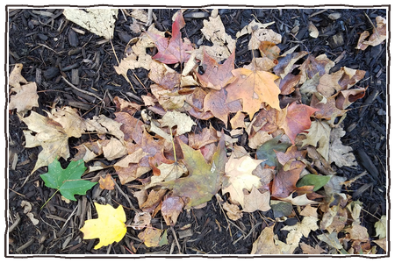
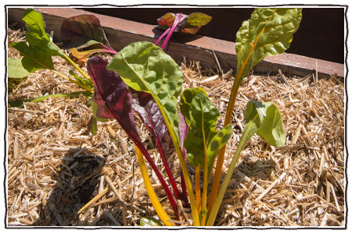
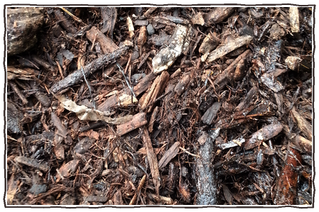
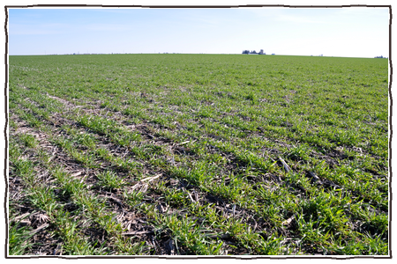
Cover it: leaf mulch, straw, woodchips or a winter cover crop.
leaf mulch
straw
woodchips
a winter cover crop
Photos: Dan Keck, CC0 1.0; Lance Cheung, USDA, Public domain; Jnzl's Photos, CC BY 2.0; Lynn Betts, NRCS/SWCS, CC BY 2.0

Slide 4

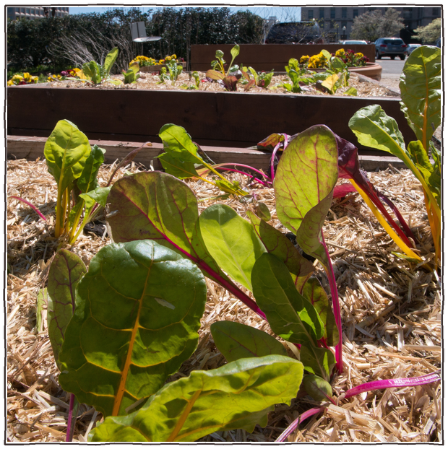

Soil life keeps working under the cover, and your beds are ready in spring.
still busy in winter
Photo: Lance Cheung, USDA, Public domain

