Slide 1

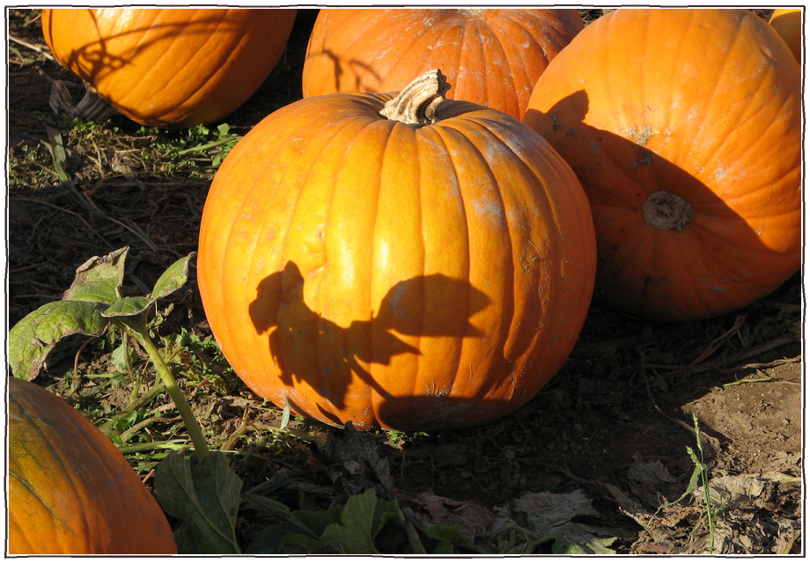

This Thanksgiving, thank the soil life that grew your dinner.
Photo: Wildcat Dunny, CC BY 2.0

Slide 2

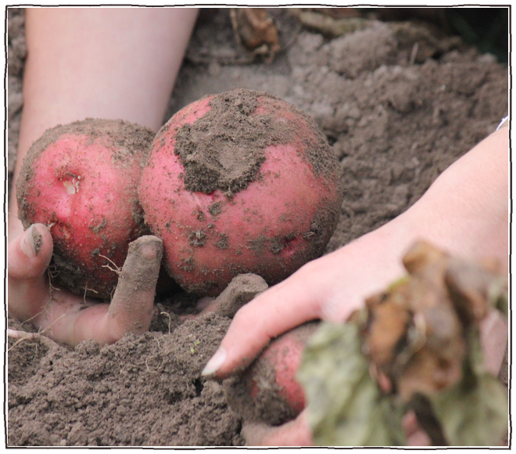
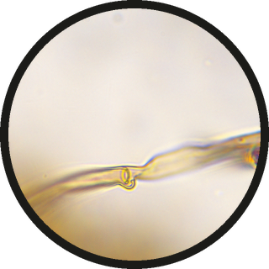
The potatoes: fungi and bacteria cycled the nutrients.
a fungal hypha at 100x
Photo: Marlene Crusta, CC BY 2.0. Micrograph: Marco Trevisan.

Slide 3

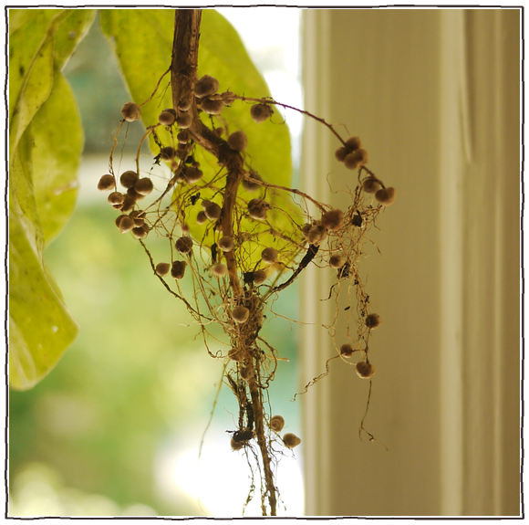

The green beans: rhizobia in the roots turned air into nitrogen.
root nodules, where rhizobia live (here on a soybean, a cousin of the green bean)
Photo: Isarnan, Public Domain Mark 1.0

Slide 4

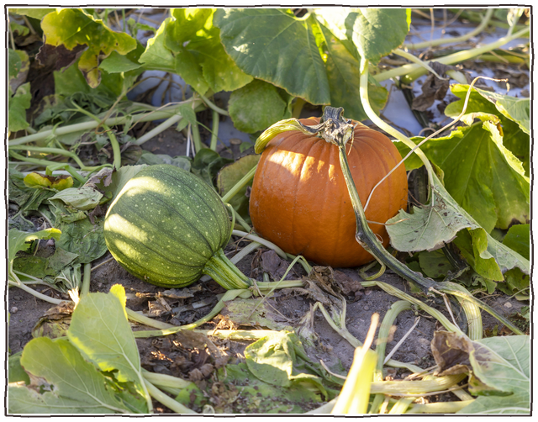
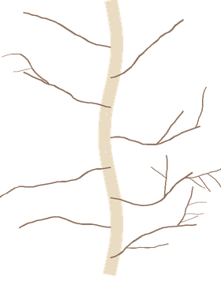
The pumpkin pie: mycorrhizal fungi helped the vines find water and phosphorus.
fungal threads at the roots
Photo: Alabama Extension, CC0 1.0

Slide 5

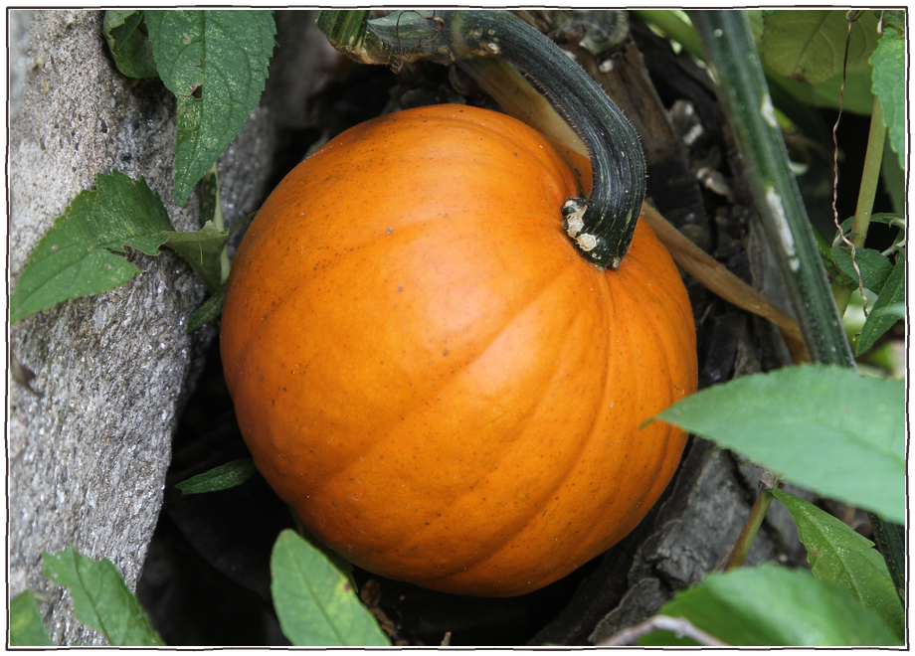
Happy Thanksgiving from all of us.
Photo: Jim, the Photographer, CC BY 2.0

