Slide 1




Happy Small
Business Saturday
Meet Colleen Dempster
of Rewild Soils

Slide 2



A Soil Food Web certified
microscopy lab since
2022
Colleen has looked at hundreds
of soil, compost and compost
tea samples

Slide 3


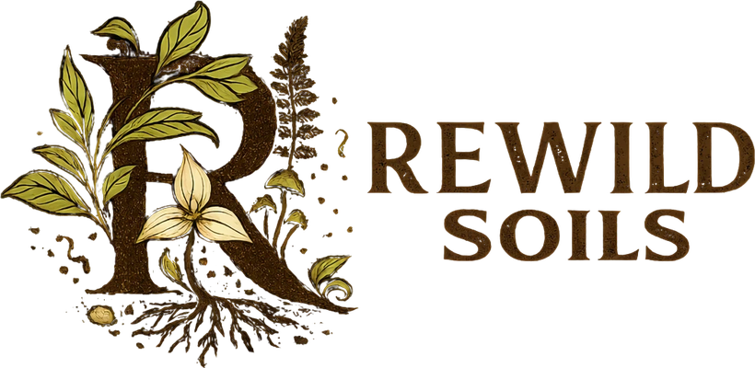


Soil microscopy, consulting,
workshops and Biologically
Complete compost from
Uxbridge, Ontario
rewildsoils.com

