Slide 1

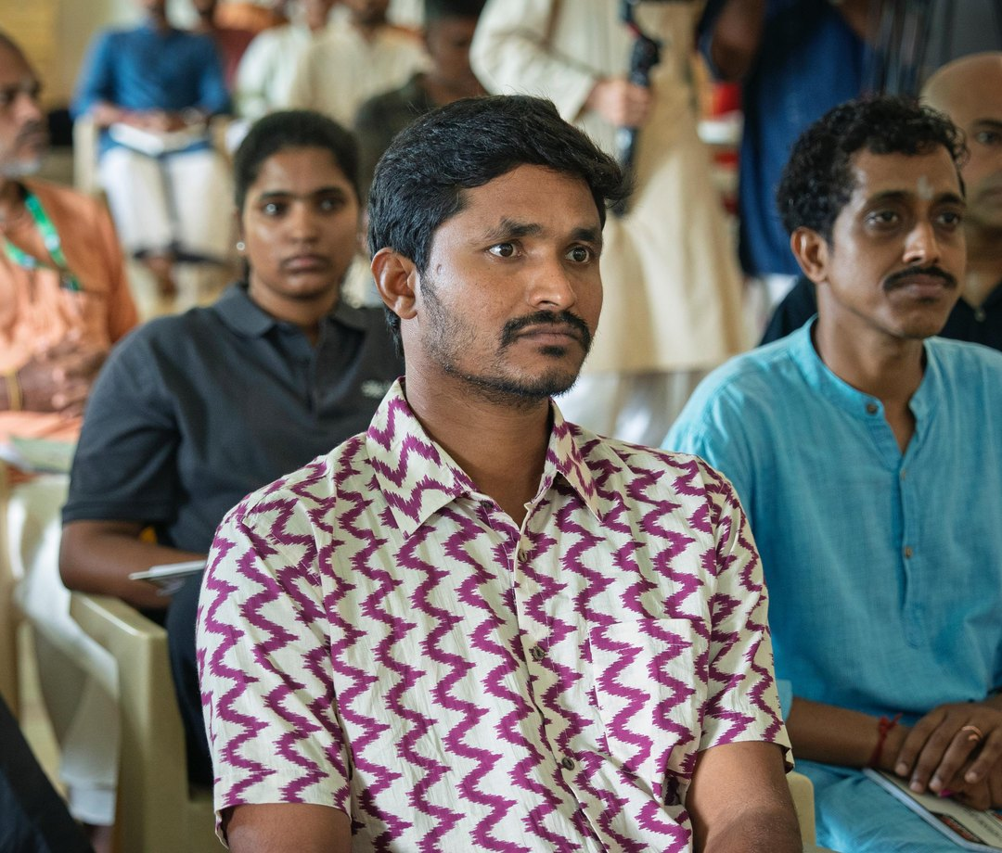

Somewhere right now, a farmer is watching their soil fail

Slide 2
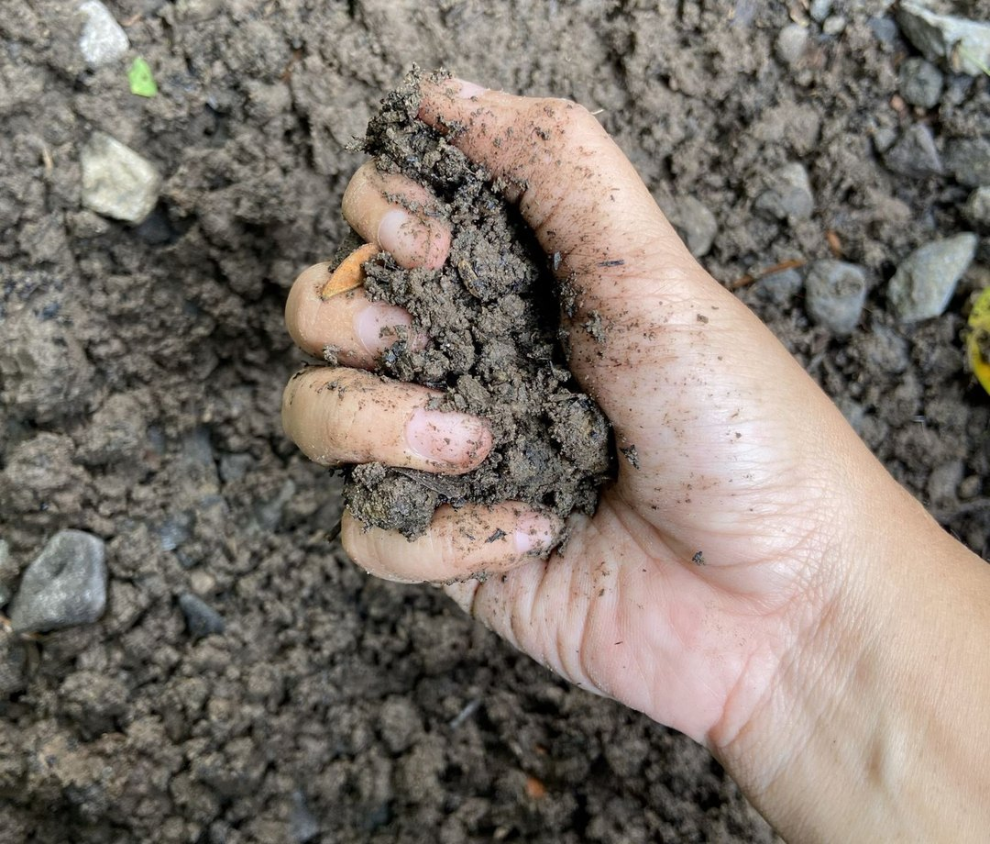
A century of practices stripped the living biology from the ground

Slide 3
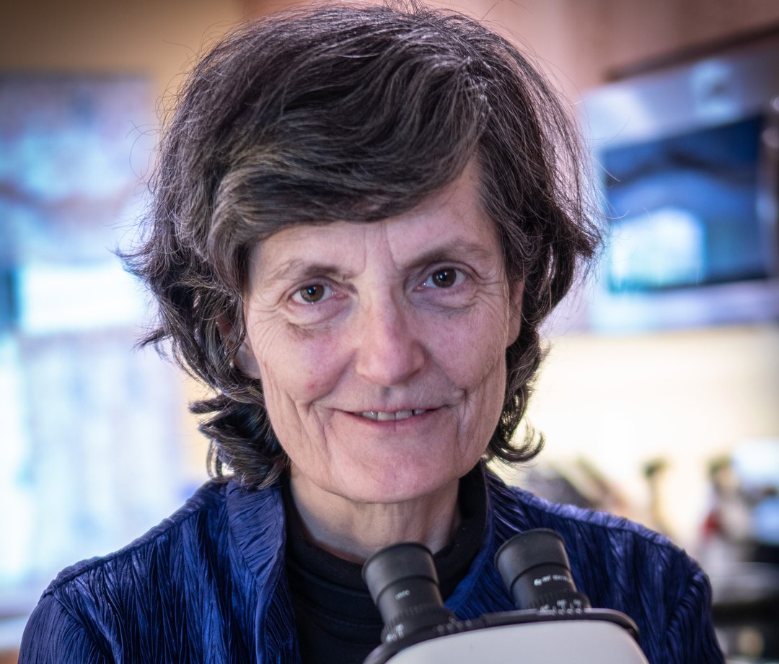
Dr. Elaine Ingham spent decades proving soil is a living community

Slide 4
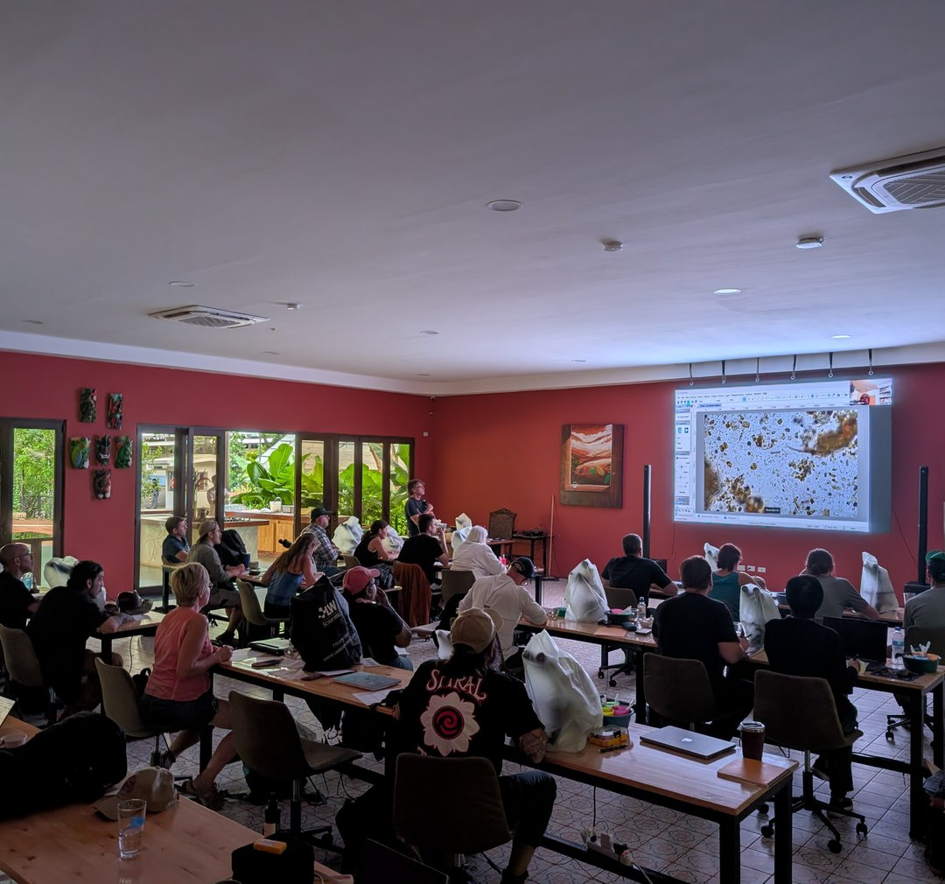
The science works. The problem is reach.

Slide 5
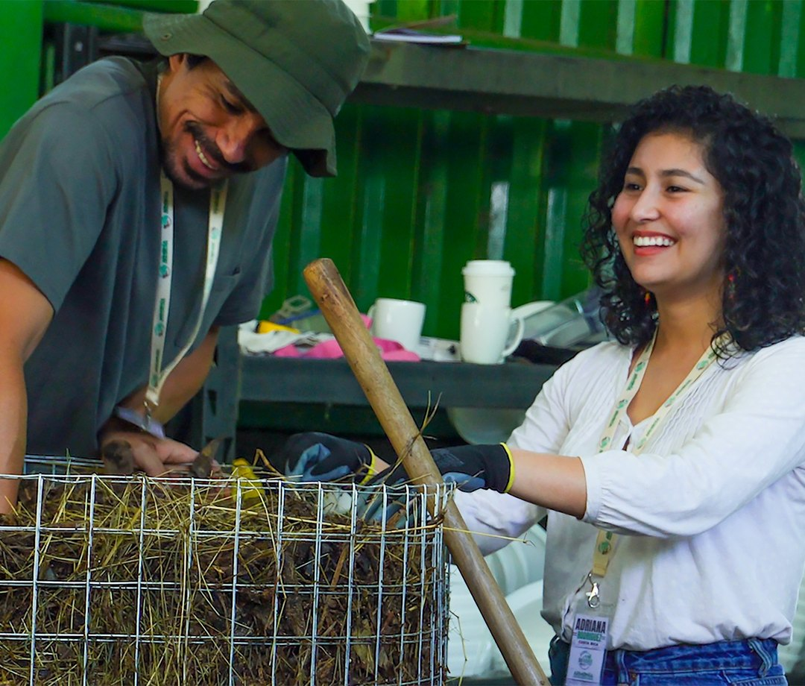
Students know this is their calling, but can’t afford the next step

Slide 6
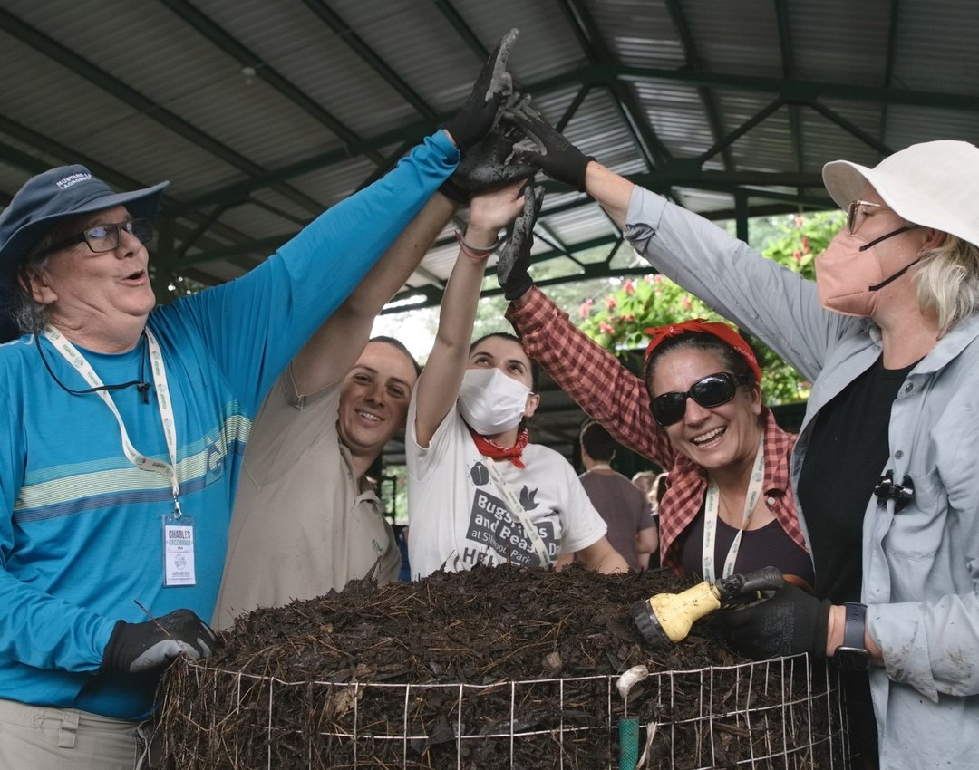
Your gift funds scholarships, educational resources and research

Slide 7
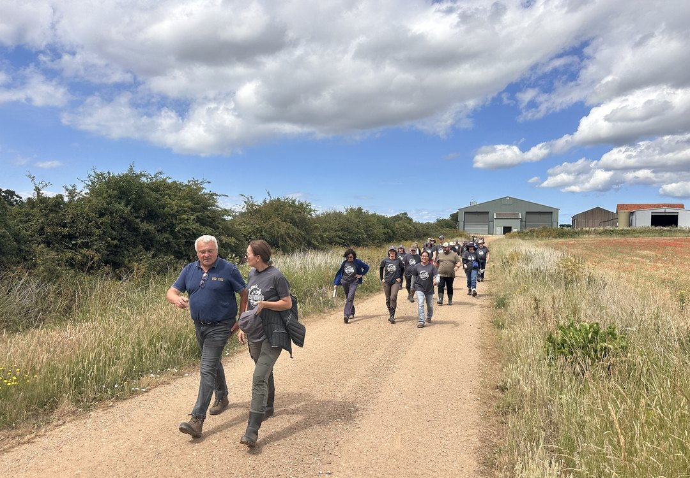

Be the mycelium
you want to see
in the world
The soil can recover.
Help us bring it back to life.
Donate · Link in bio

