Slide 1
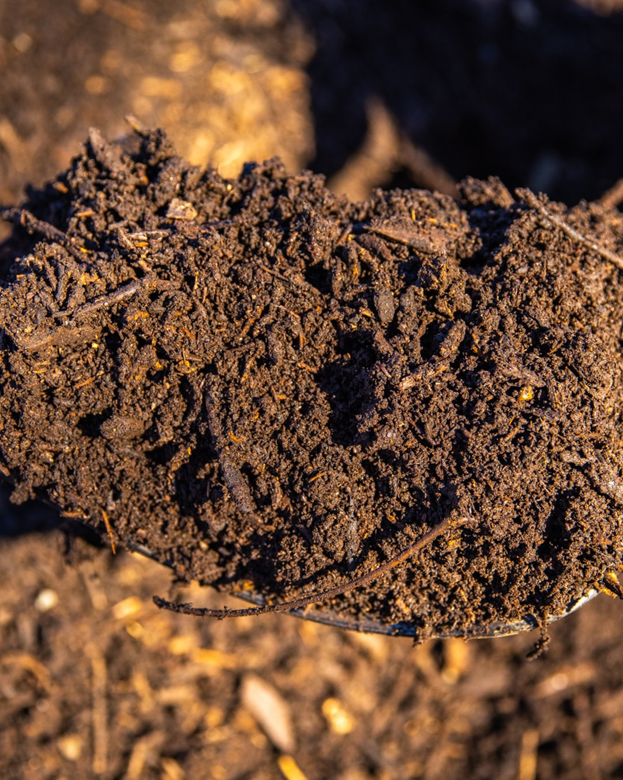

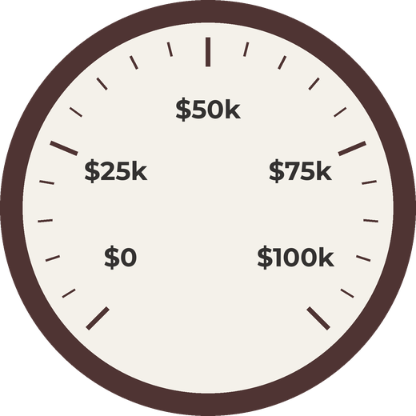


$100,000 for
living soil
Giving Tuesday · 1 December

Slide 2
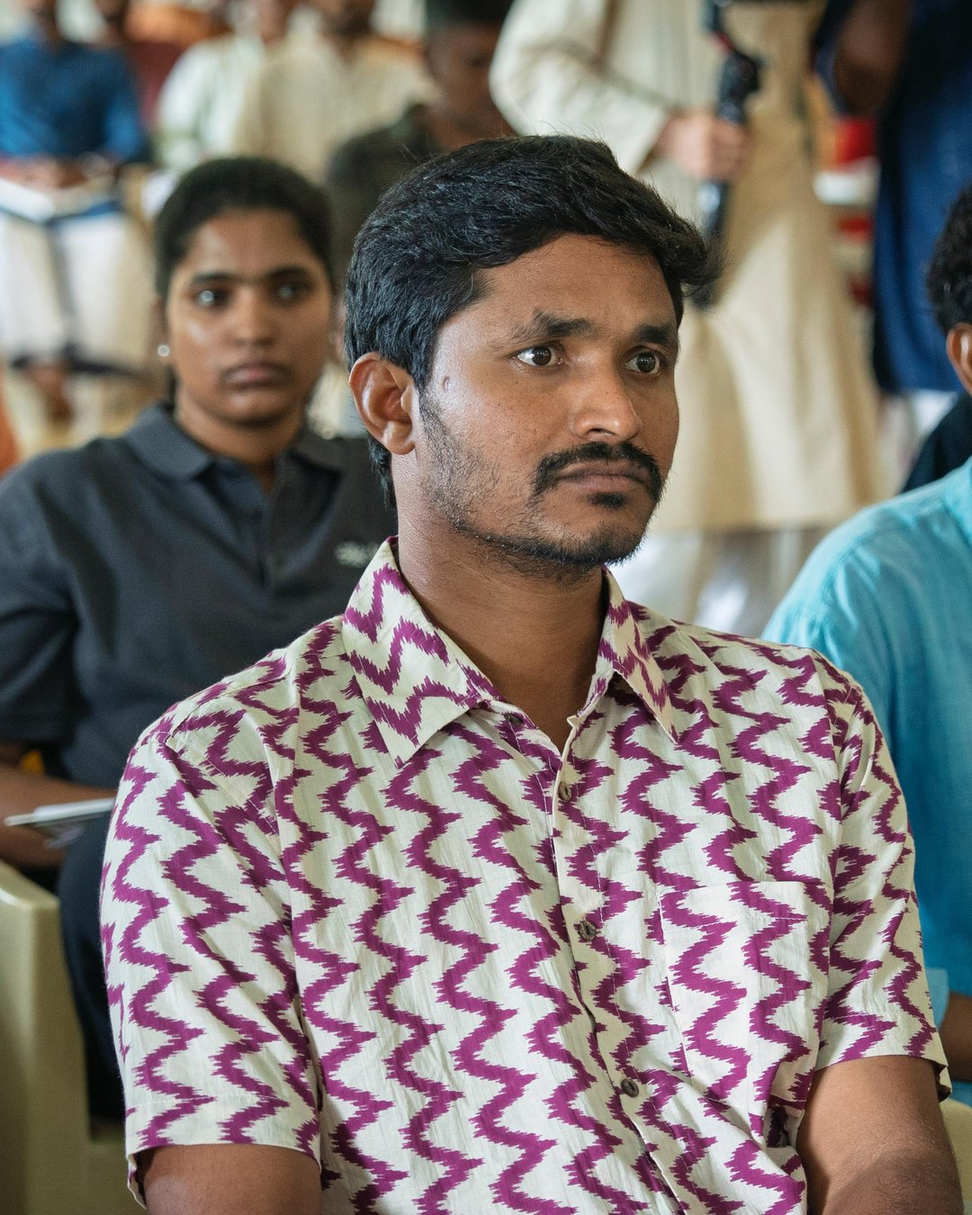


Healing soil.
Feeding humanity.
Restoring the
living world.

Slide 3
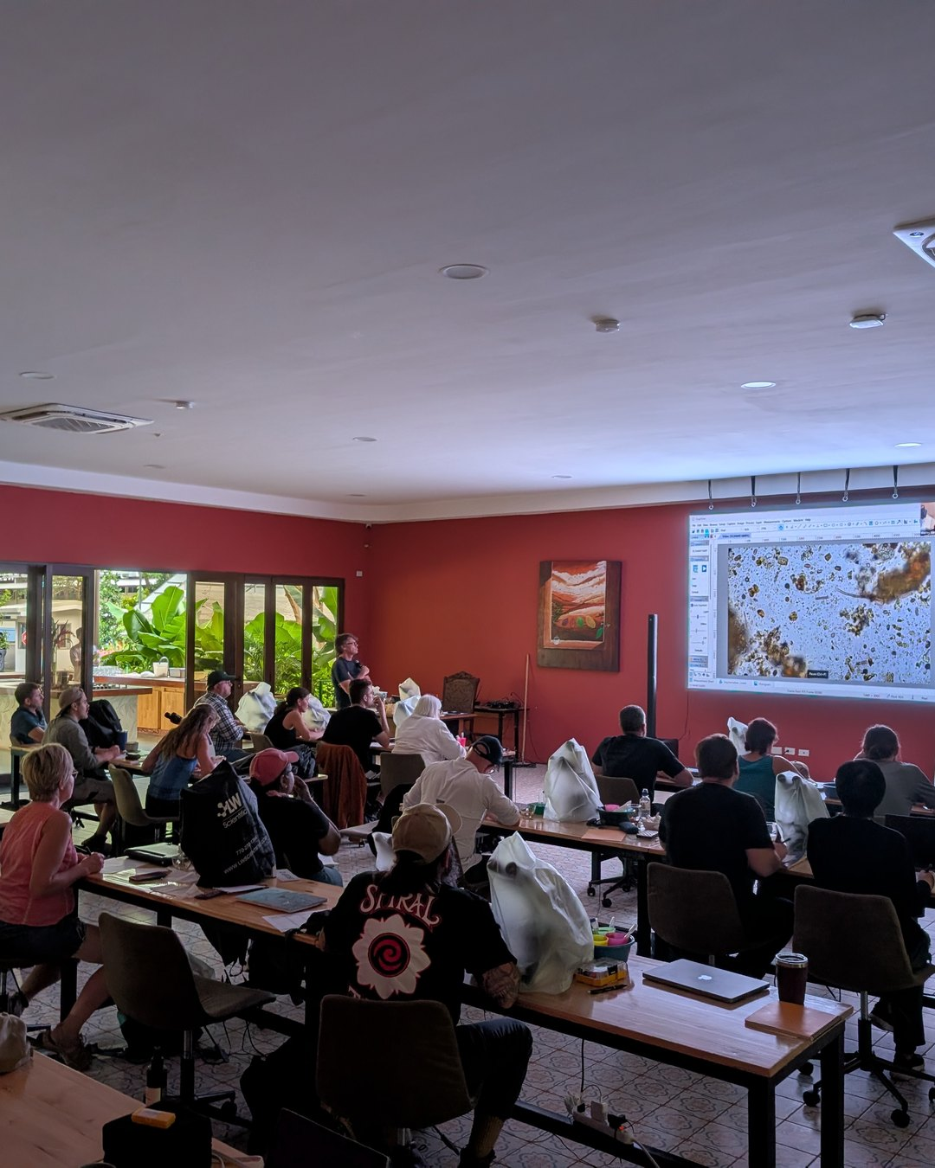


We teach farmers, agronomists and consultants to bring their soil back to life.

Slide 4
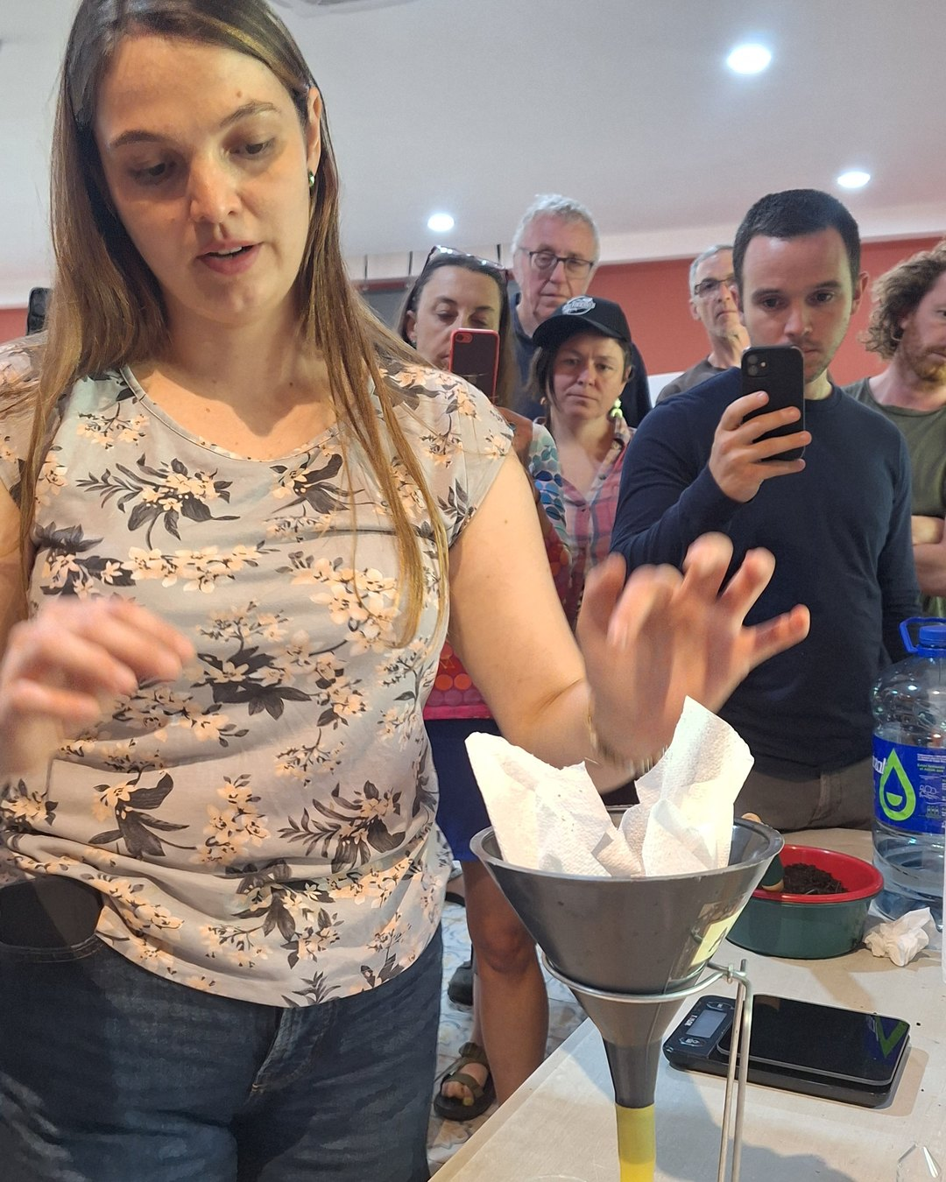


Slide 5
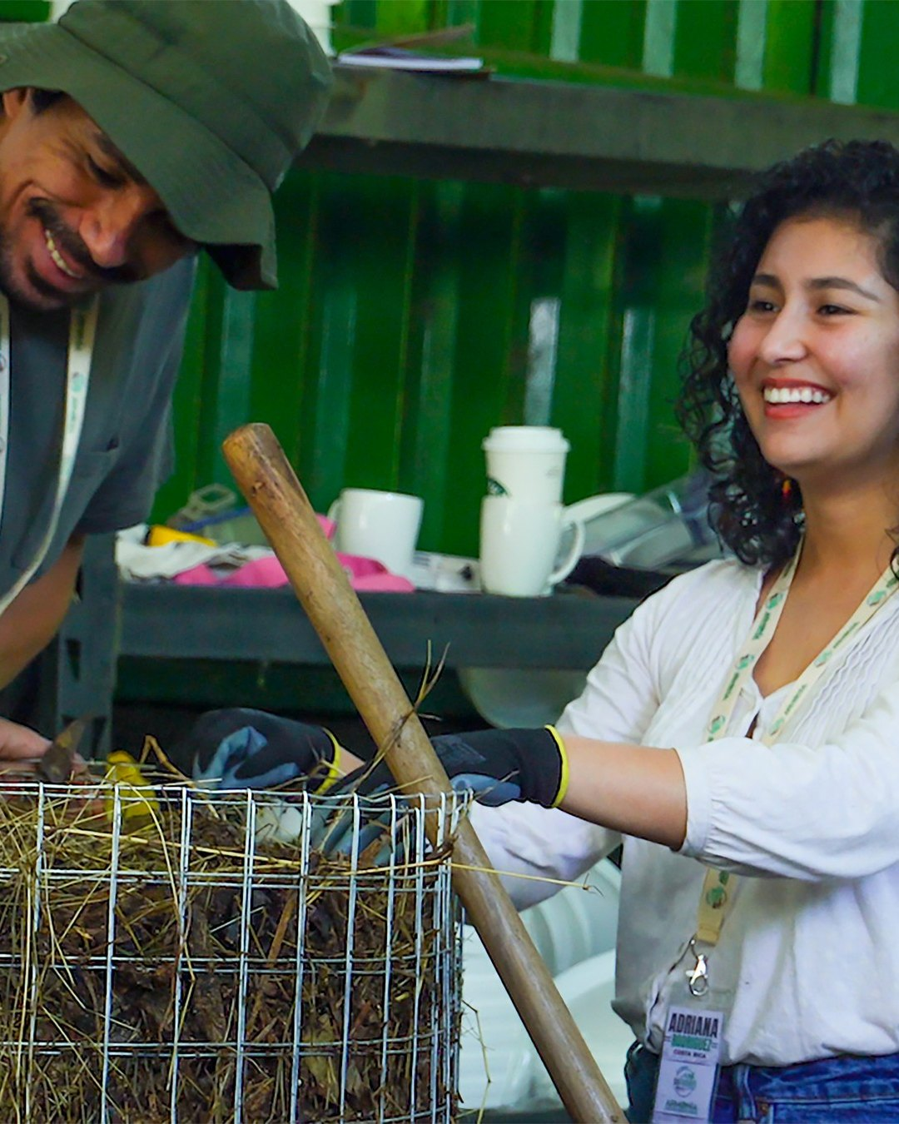


Slide 6
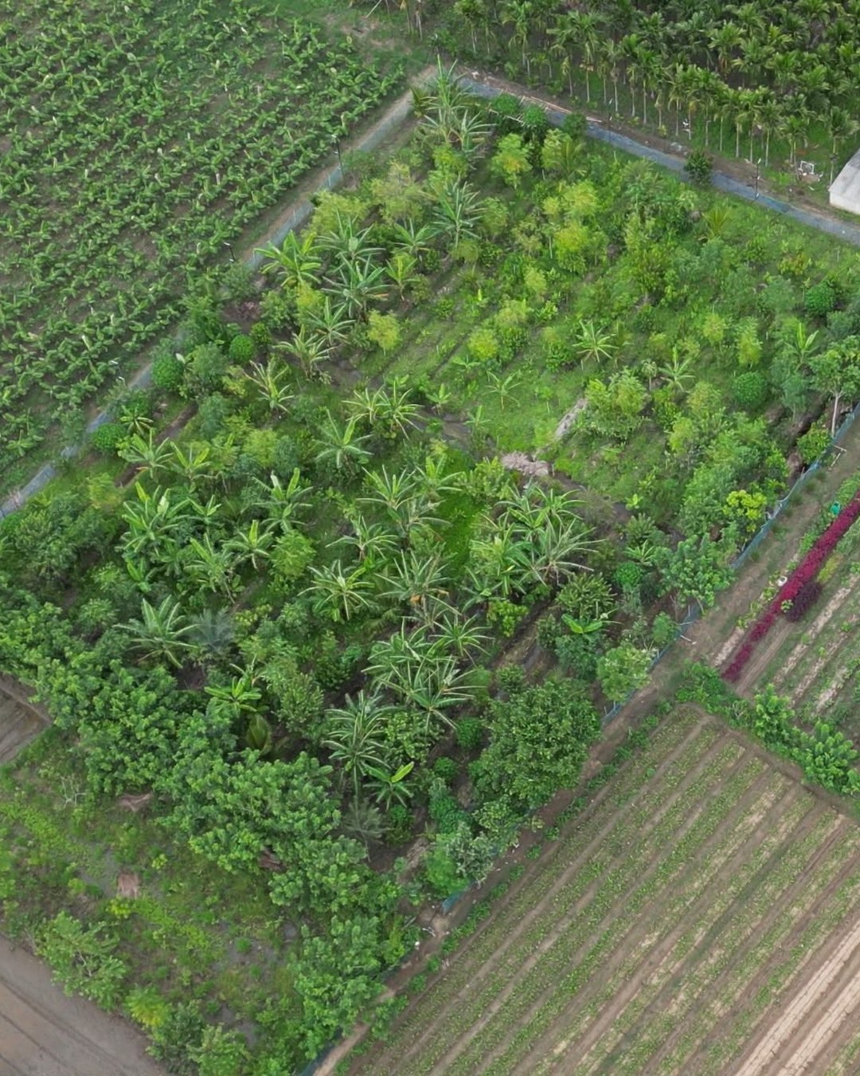


Costa Rica · New Mexico · England
Cyprus · India

Slide 7



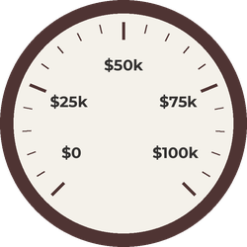


PHOTO: pink tree in bloom
(800DA1A4, Costa Rica 2025)
Be the mycelium you want to see in the world.
$100,000 for scholarships, educational resources and research. Donate today.

