Slide 1

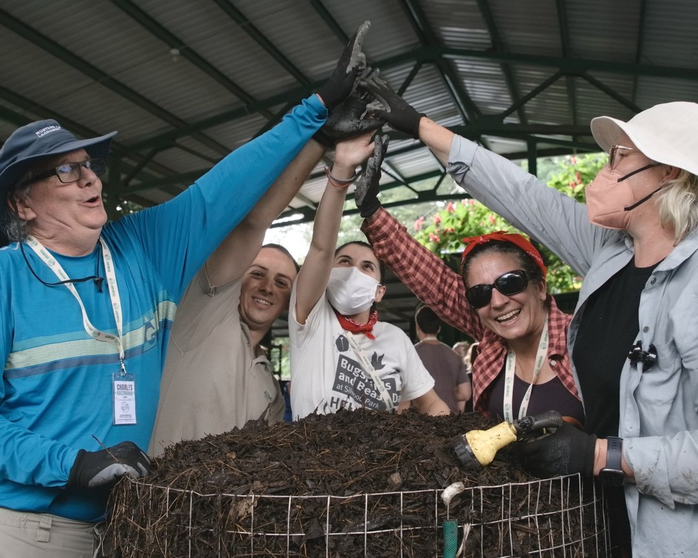
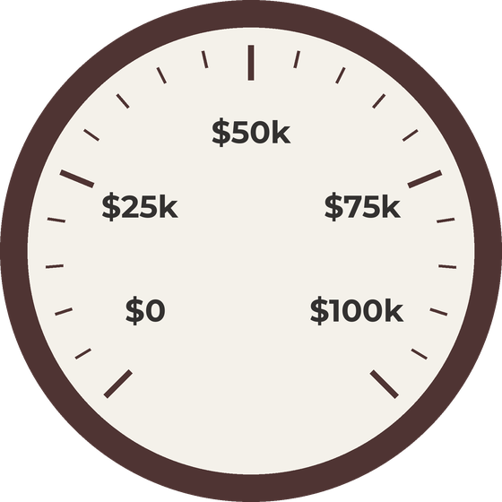

$10,000 raised.
Help us reach $100,000.

Slide 2
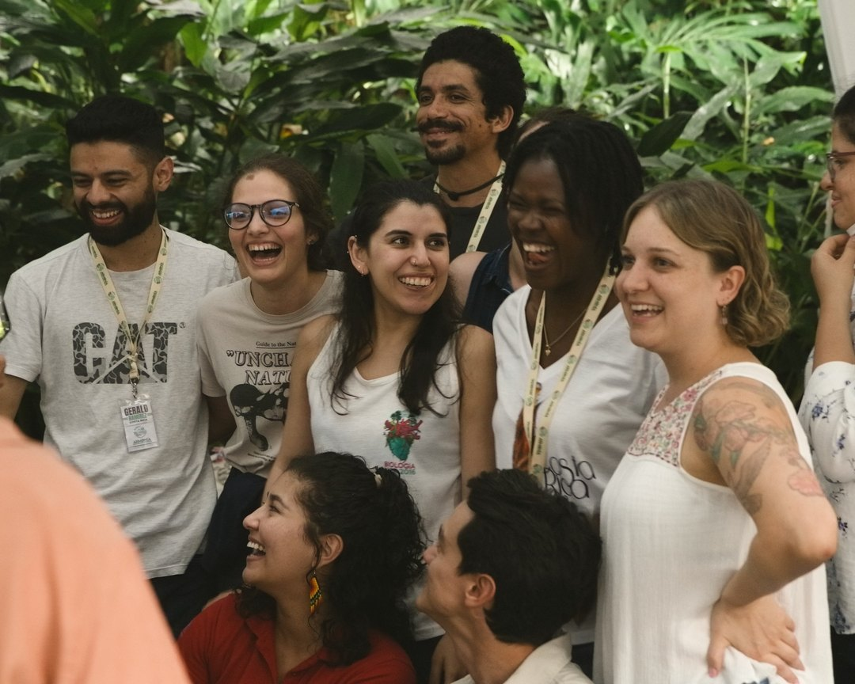

$25,000 raised.
Help us reach $100,000.

Slide 3
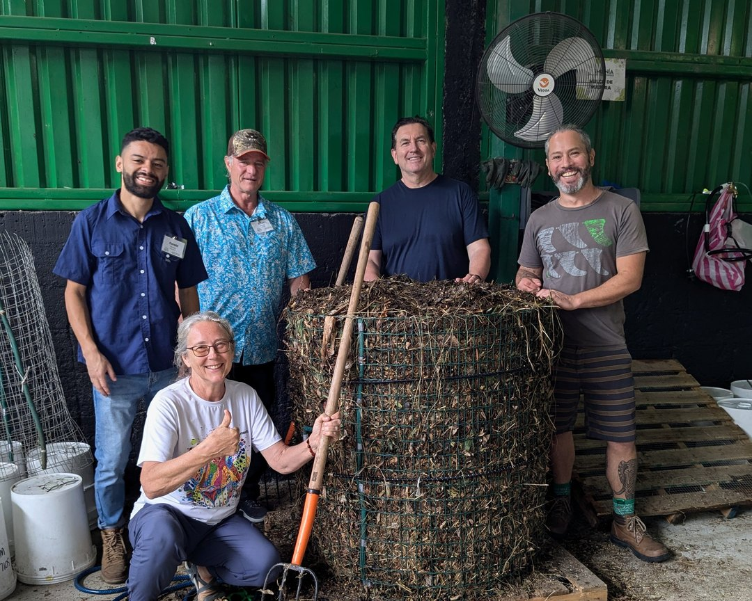
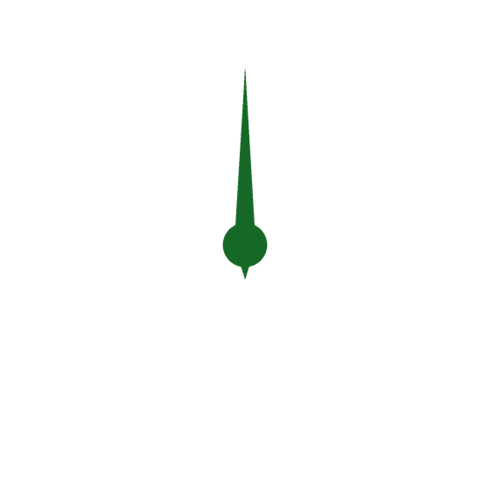
$50,000 raised.
Help us reach $100,000.

Slide 4
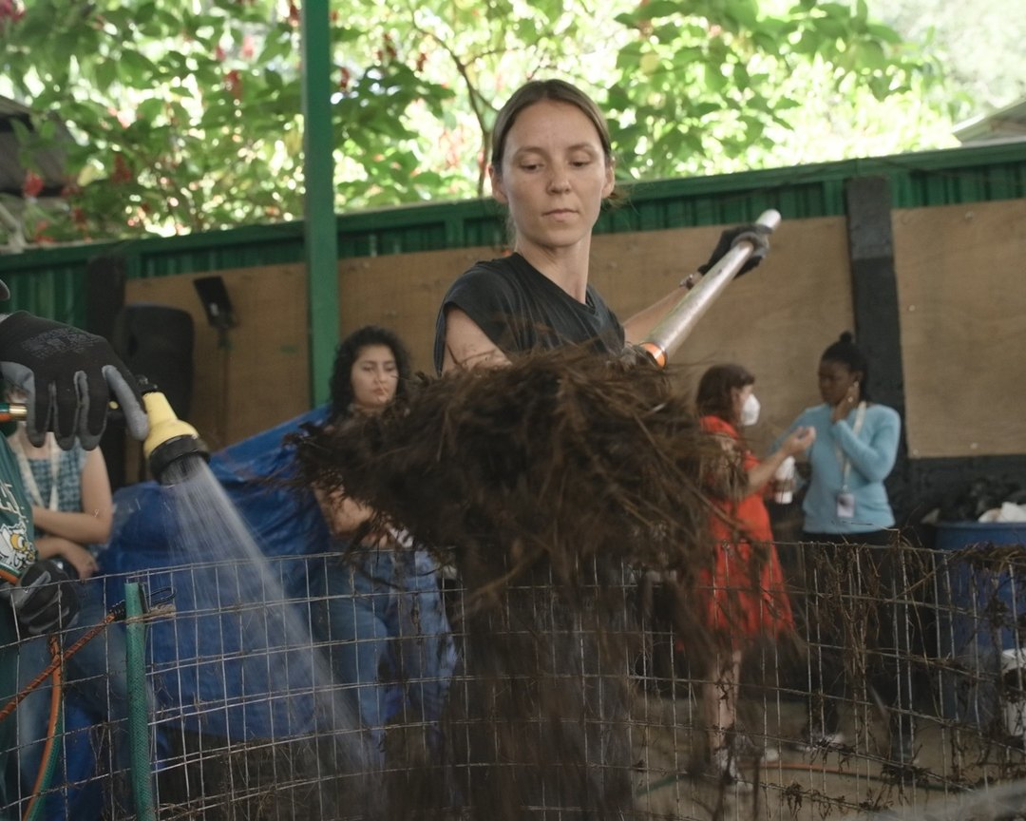

$75,000 raised.
Help us reach $100,000.

Slide 5
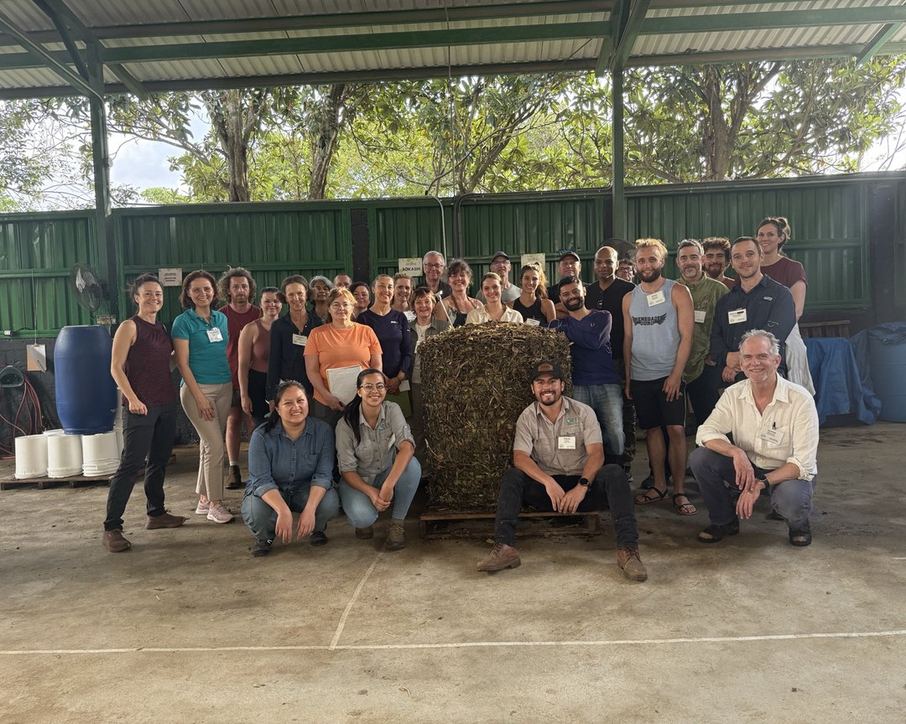

We did it.
Thank you.

