Slide 1

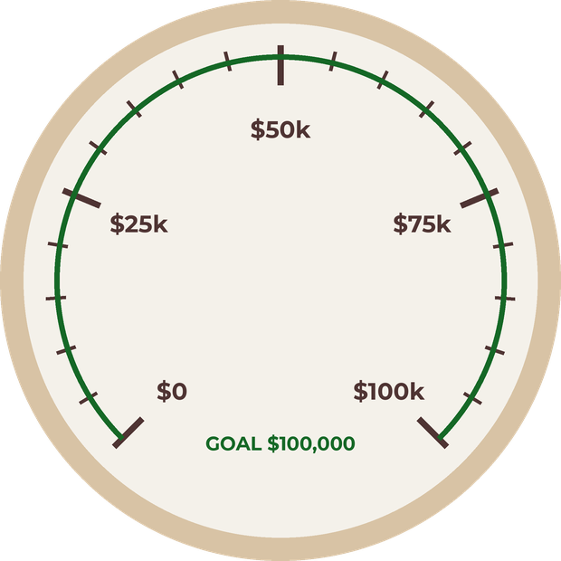



GivingTuesday · December 1
Help us raise $100,000
to bring soil back to life
Give today

Slide 2

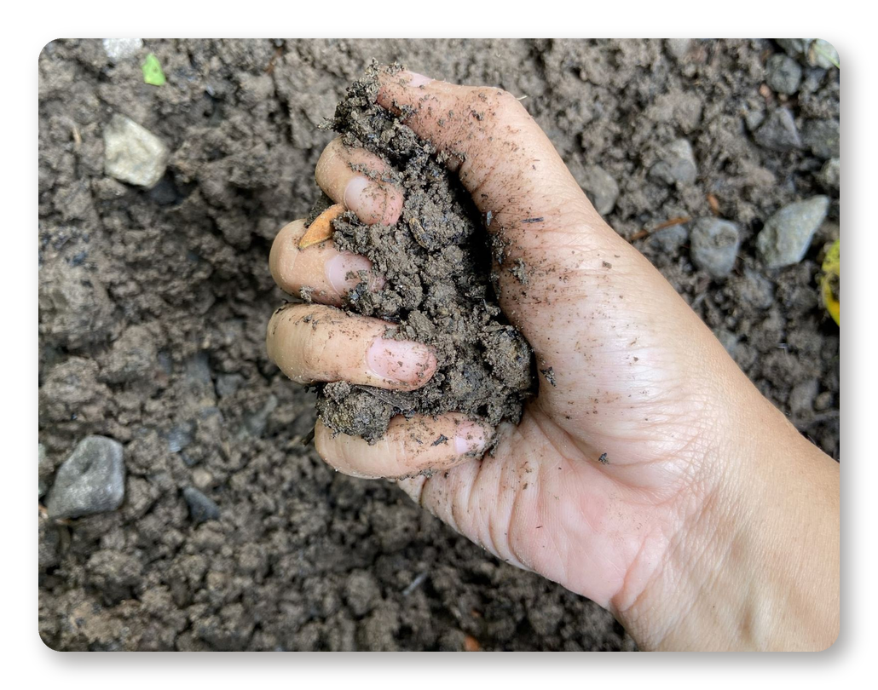
The soil under our feet is alive
For decades we’ve farmed it
like it was dead.

Slide 3

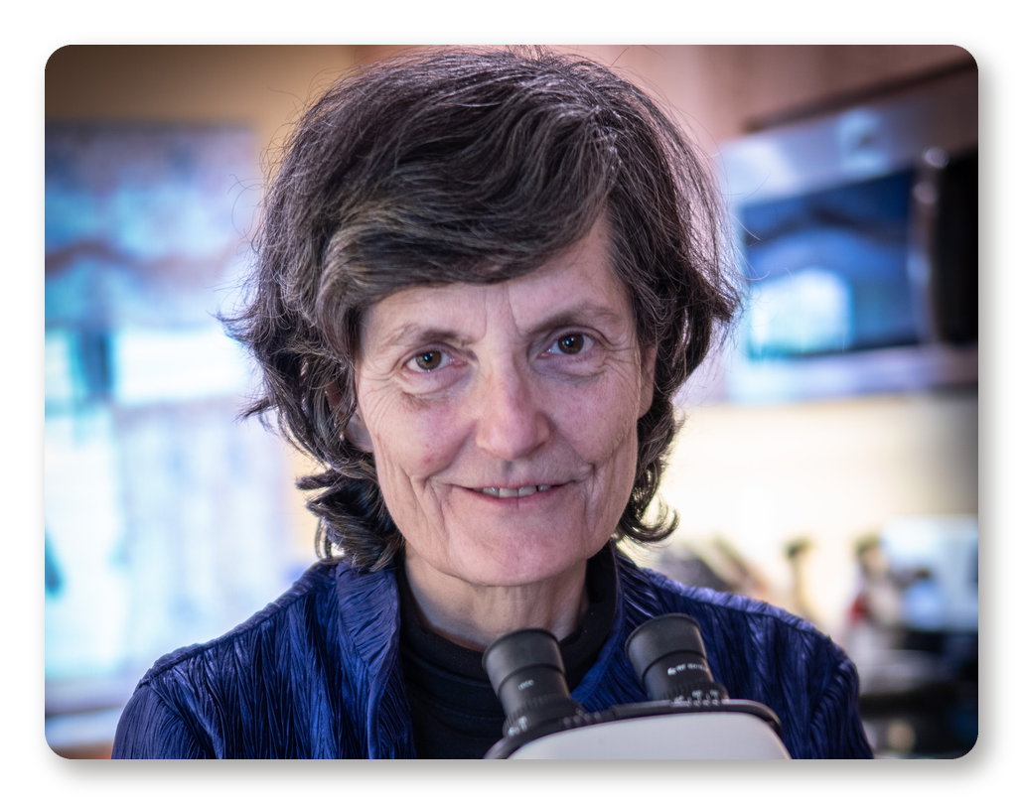
Healthy food comes from healthy soil
Dr. Elaine Ingham spent
decades proving it.

Slide 4

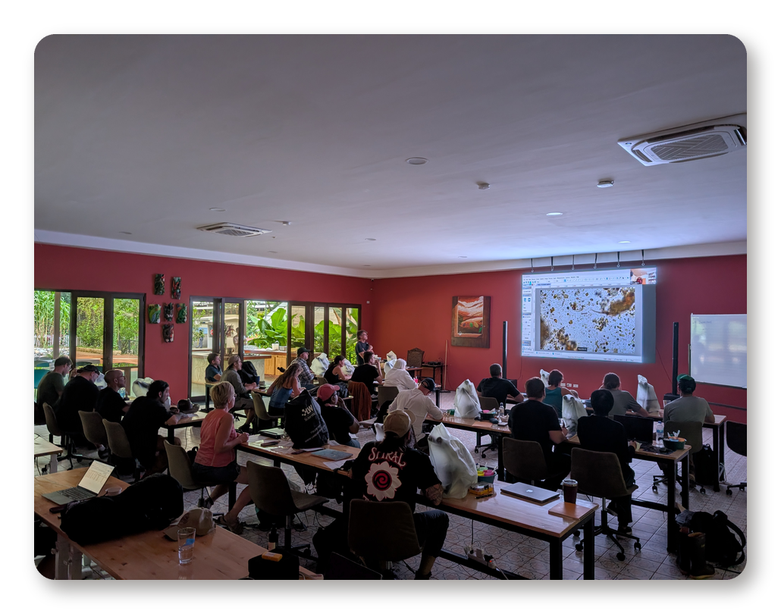
We teach farmers to restore the living web in their soil

Slide 5

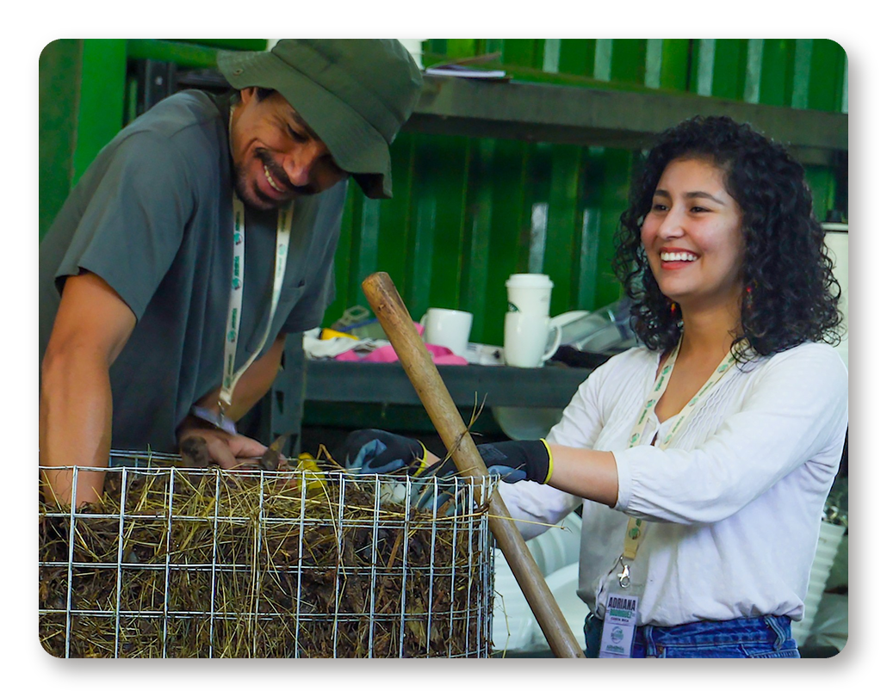
One trained farmer changes a whole farm
Then the neighbours see
the results and ask how.

Slide 6

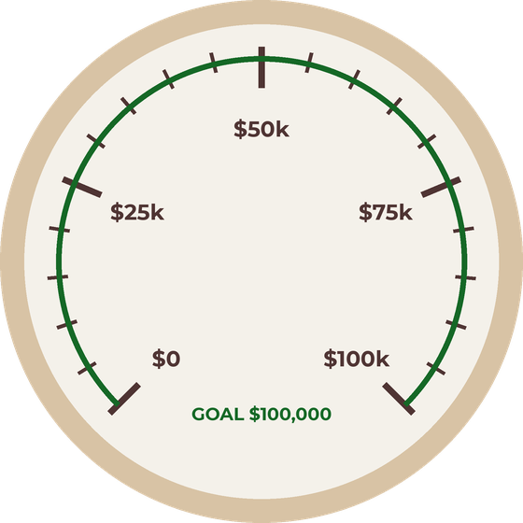


Be the mycelium you want
to see in the world
Your gift funds scholarships, educational
resources and research
Donate today

