Slide 1
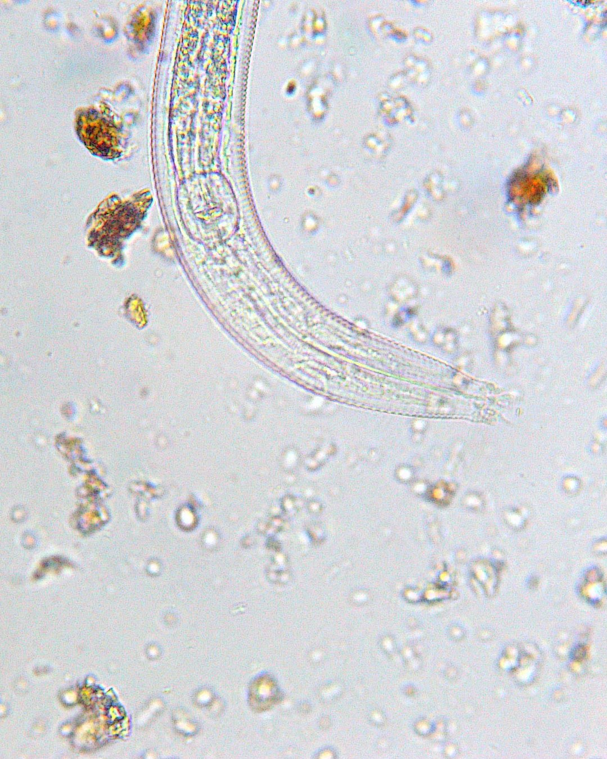





JOIN US TOMORROW
Why nematodes make great compost
Dr. Craig Kolodge
[affiliation]
Wed 2 Dec
9am Pacific, free
Bacterial-feeding nematode. Photo: Talbot Armstrong

