Slide 1

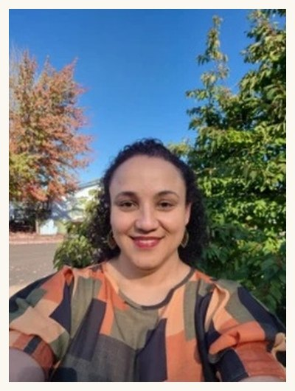

FOOD AS MEDICINE FOR ALL
Dr. Carla Portugal speaks on soil and nutrition
Sunday 15 November, 7 to 7:45am Pacific
Livestream conference

Slide 2


HER TALK
Restoring the Soil Food Web to Grow Nutrition Your Patients Need
The nutrient density of food is partly a biological property of the soil it grew in. Carla translates soil biology into clinical language for nutrition specialists.
2026 Food as Medicine for All, 14 to 15 November. Link in bio

