Slide 1



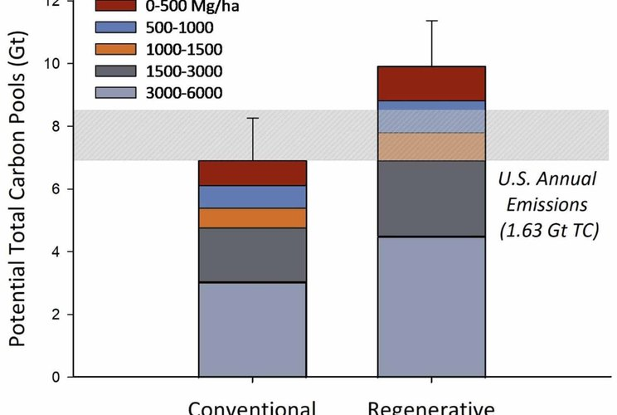


ENVIRONMENTAL RESEARCH: FOOD SYSTEMS
Figure 2, Lundgren et al. 2026, CC BY 4.0
The most regenerative farms stored 39% more carbon in their soil
Lundgren et al. 2026, Environmental Research: Food Systems. The 1000 Farms Initiative, Ecdysis Foundation.
Read More
Source:
doi.org/10.1088/2976-601X/ae8f4e

Slide 2


The 1000 Farms Initiative measured 210 working farms across North America, from the most conventional to the most regenerative.
Led by Ecdysis Foundation

Slide 3

39% more total soil carbon on the most regenerative farms.

Slide 4

+181% total fungi in the most regenerative soils.
Lundgren et al. 2026, figure 3

Slide 5

More life everywhere: soil microbes, insects, plants and birds. The more biodiversity, the more carbon stored.

Slide 6

Regenerative yields matched national averages, and net profit per acre was similar.

Slide 7

One practice alone changed nothing. Farms using a single regenerative practice looked like conventional farms. The whole system matters.

Slide 8

Read the paper: Lundgren et al., Environmental Research: Food Systems, 2026.
Full paper: link in bio.

