Slide 1



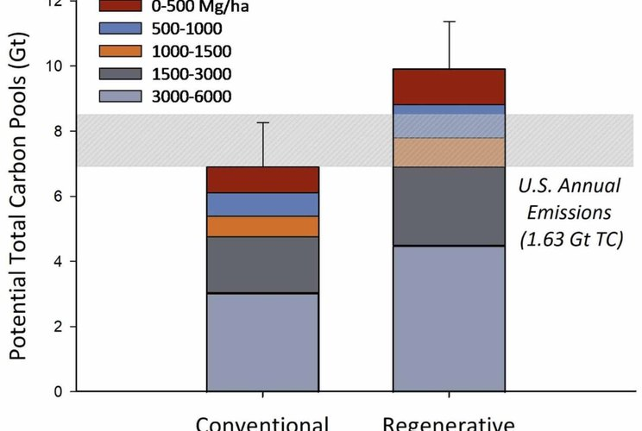


ENVIRONMENTAL RESEARCH: FOOD SYSTEMS
Figure 2, Lundgren et al. 2026, CC BY 4.0
The most regenerative farms stored 39% more carbon in their soil
Lundgren et al. 2026, Environmental Research: Food Systems. The 1000 Farms Initiative, Ecdysis Foundation.
Read More
Source:
doi.org/10.1088/2976-601X/ae8f4e

Slide 2


More soil life too: +181% total fungi, and more microbes, insects, plants and birds.
Lundgren et al. 2026, figure 3

Slide 3

Yields matched national averages and profit was similar. One practice alone changed nothing: the whole system matters.
Full paper: link in bio.

