Slide 1

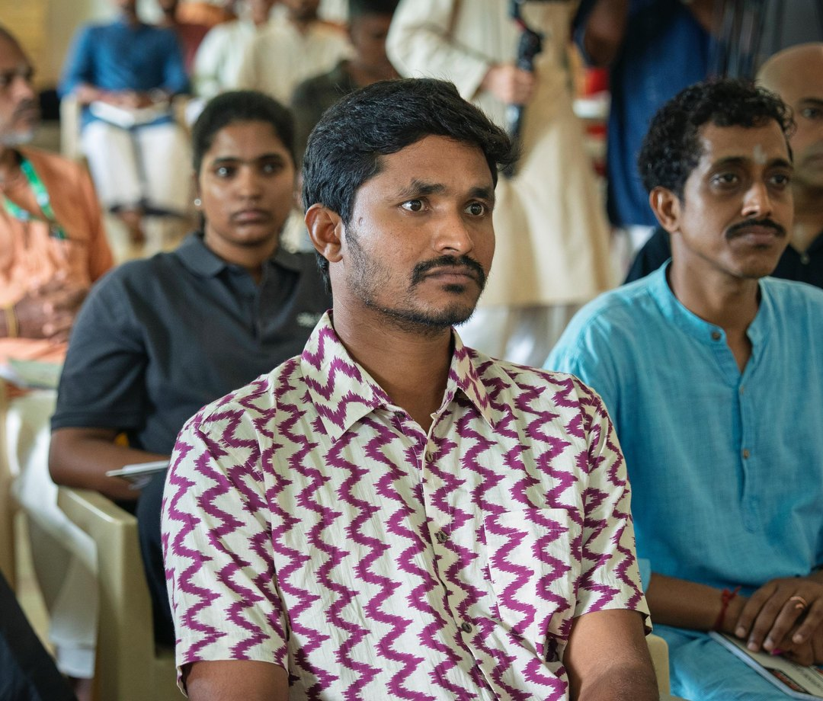

There is a farmer somewhere right now watching their soil fail

Slide 2


Not from drought or bad luck, but from a century of practices that stripped the living biology from the ground

Slide 3
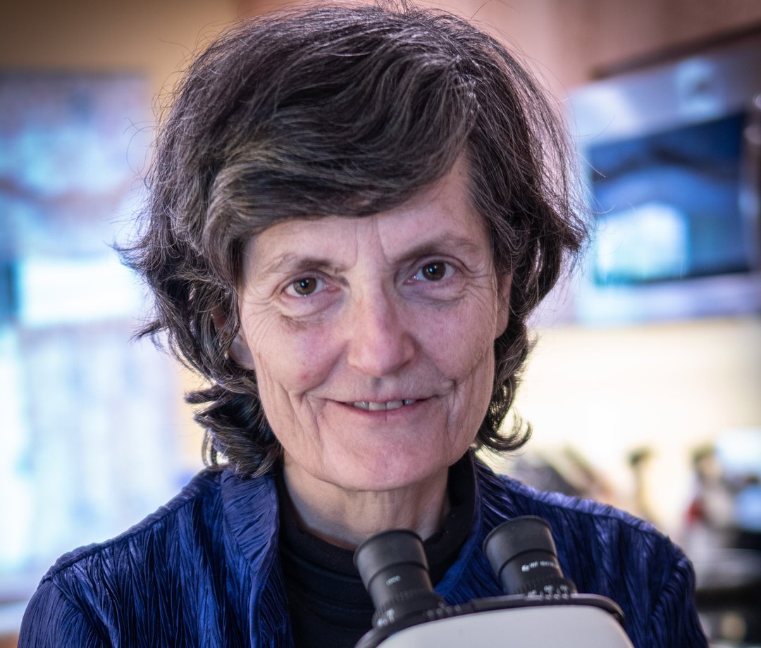
Dr. Elaine Ingham spent decades proving that soil is a living community

Slide 4

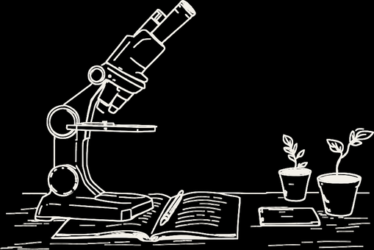
The science is sound.
The methodology works.
The problem is reach.

Slide 5
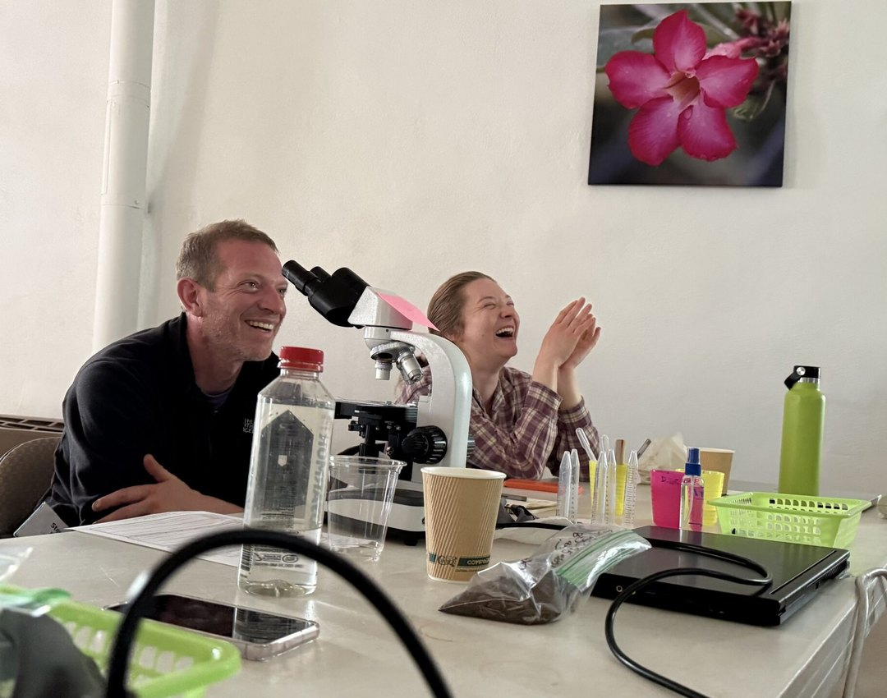
There are students who know this is their calling but cannot afford the next step

Slide 6

Every gift at any level funds scholarships, educational resources, and research
$50,985 raised of our $100,000 goal

Slide 7

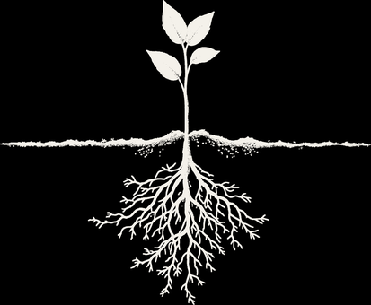

The soil can recover.
It wants to.
Donate · Link in bio

