Slide 1

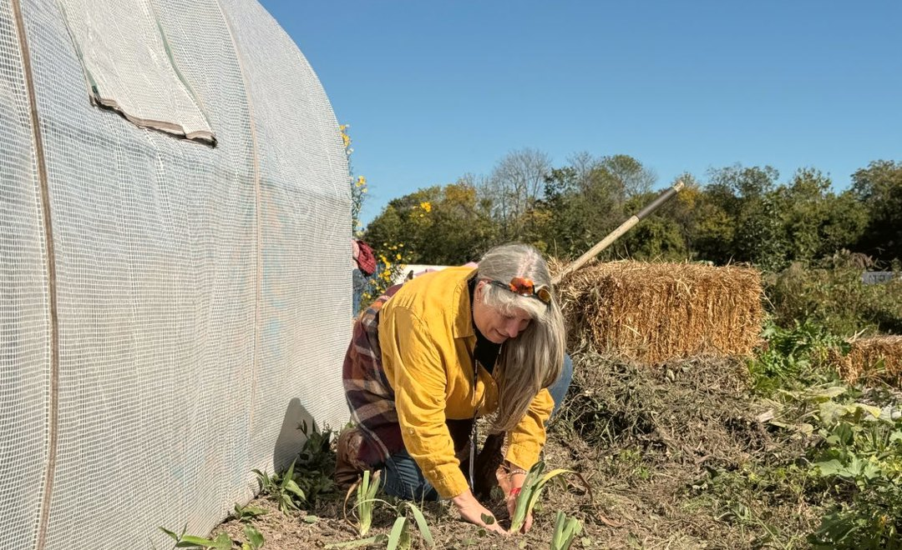

SOIL FOOD WEB · FIELD REPORT
PEOPLE
Photo: Suzanne Shea
FARMER VETERANS
Veteran farmers are building living soil
Consultant Suzanne Shea took the soil food web to the Farmer Veteran Coalition.

Slide 2

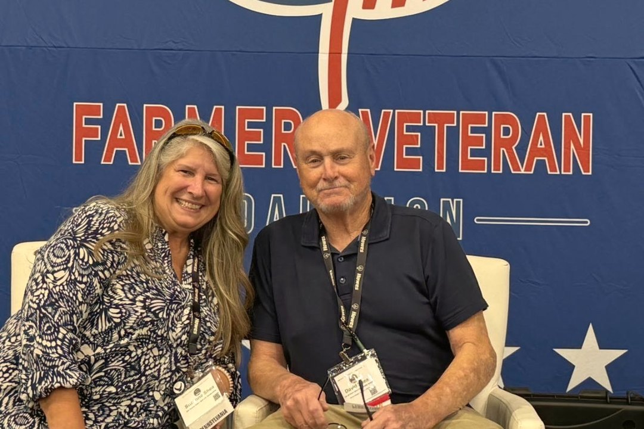
SOIL FOOD WEB · FIELD REPORT
THE TALK
STAKEHOLDERS CONFERENCE
“Scaling Sustainably”
Farmer Veteran Coalition
Suzanne Shea presented her talk at
the Farmer Veteran Coalition
Stakeholders Conference.

Slide 3

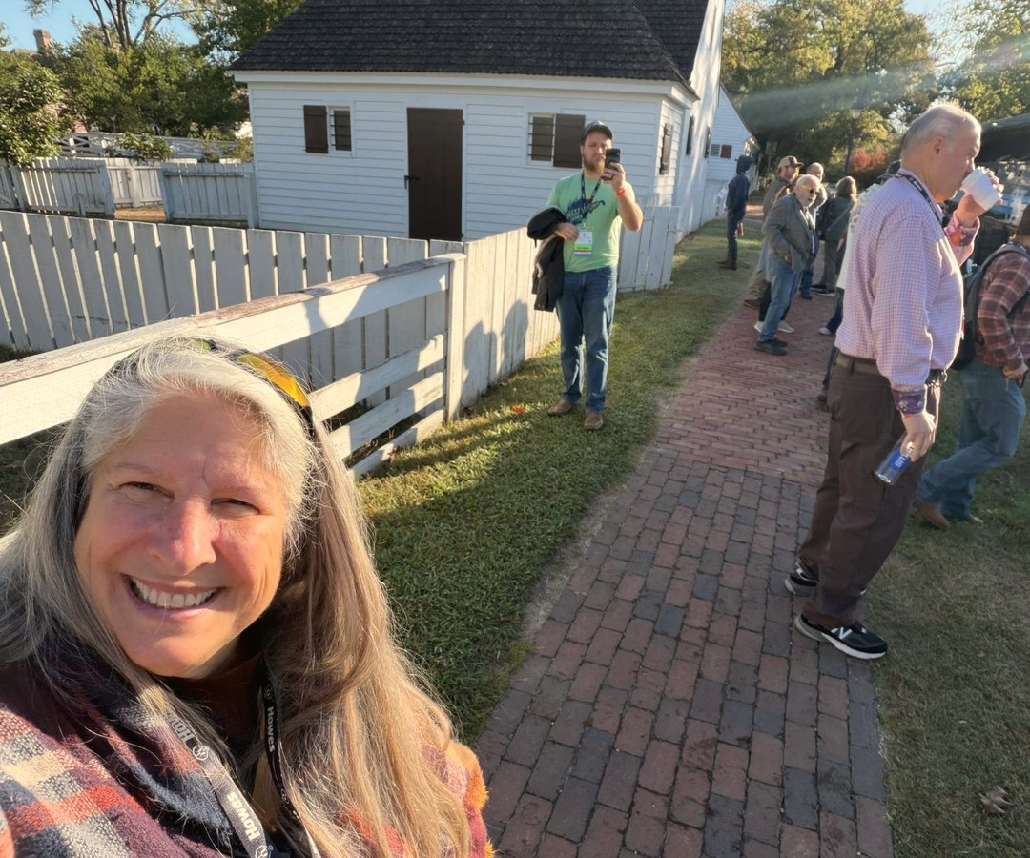
SOIL FOOD WEB · FIELD REPORT
PHOTOS
Photo: Suzanne Shea
Find a Soil Food Web
consultant near you

