Slide 1
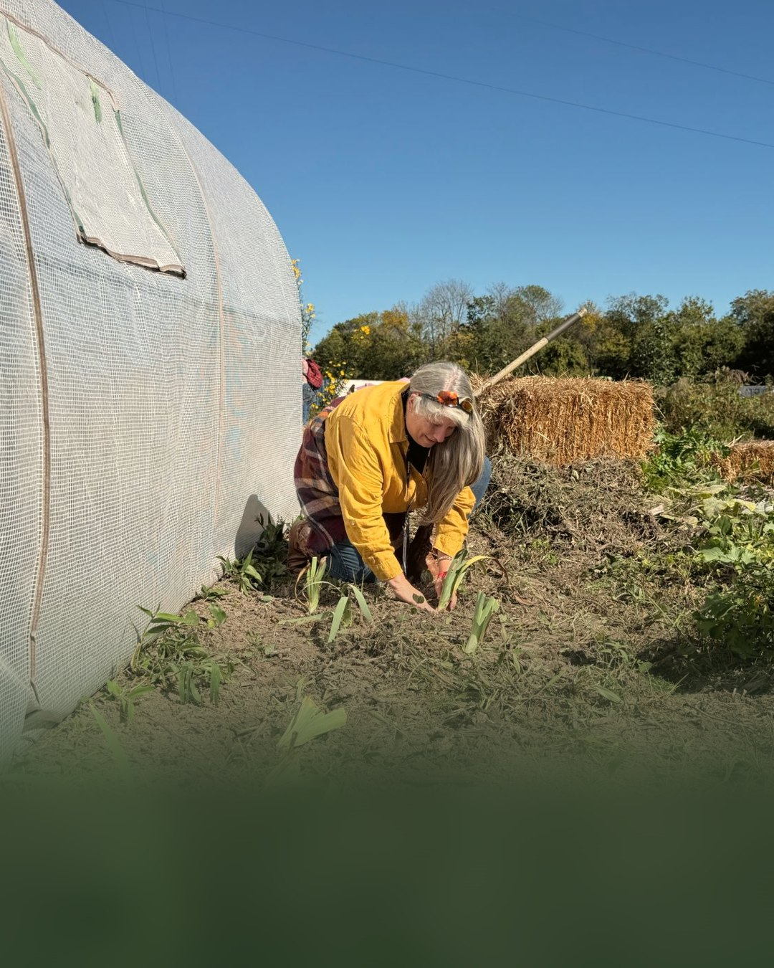

Farmer Veteran Coalition
Veteran farmers
building living soil
With Soil Food Web Consultant
Suzanne Shea

Slide 2
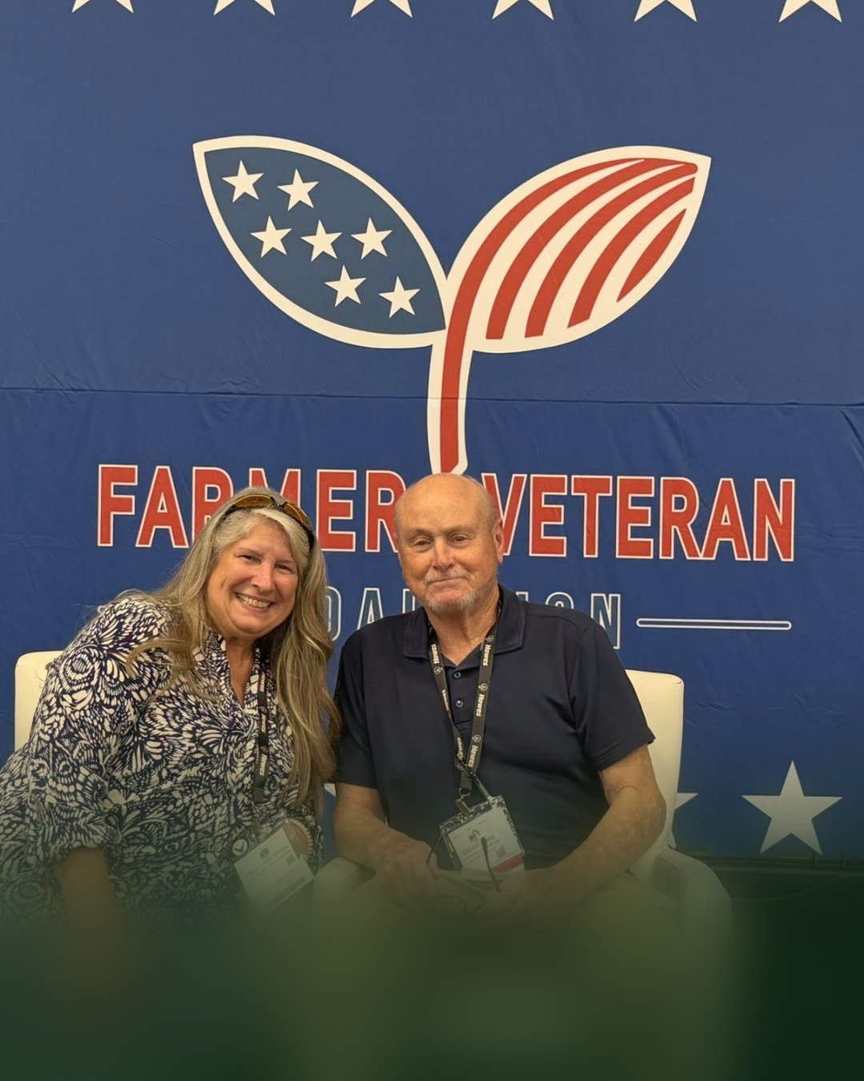
Stakeholders Conference
“Scaling Sustainably”
Suzanne Shea’s talk at the
Farmer Veteran Coalition

Slide 3
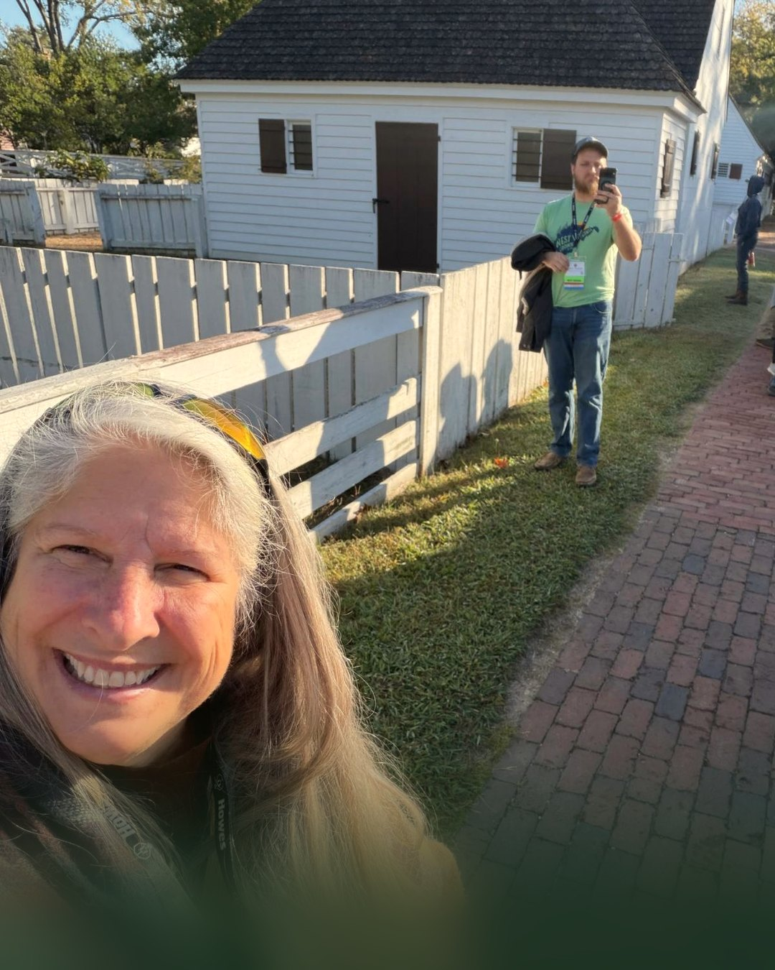
Soil Food Web Consultants
Find one
near you

