Slide 1



PHOTO: the conference speaker grid,
unchanged (Linnea uploads)

Slide 2

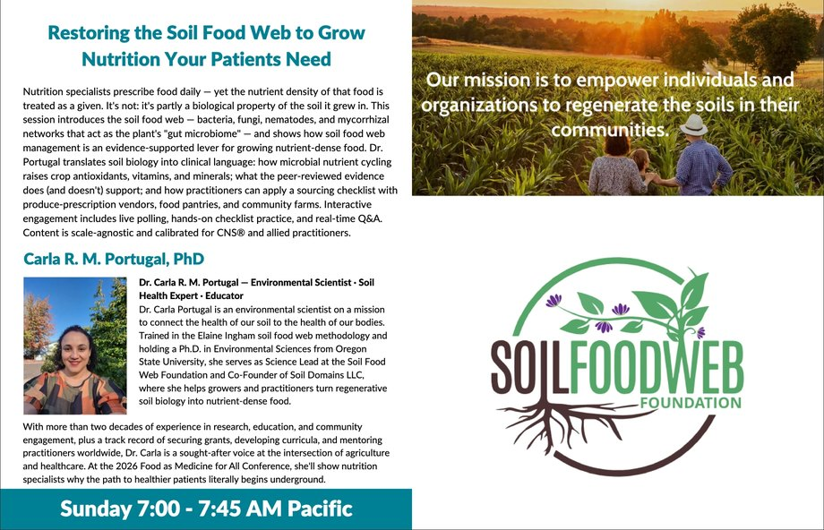

Slide 3

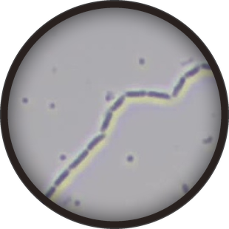
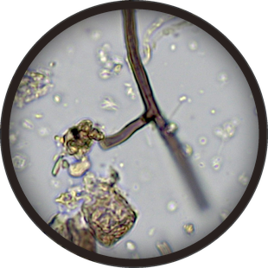
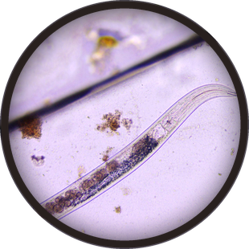
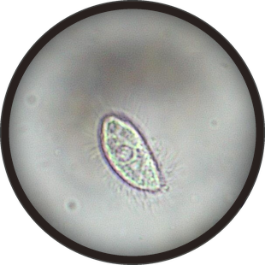

Plants have a gut
microbiome too
Bacteria · John Ash
Fungi · Tanja Dekker
Nematode · Sid Jensen
Protozoa · Gerri Gassert
The soil food web feeds the plant,
like gut microbes feed us

Slide 4

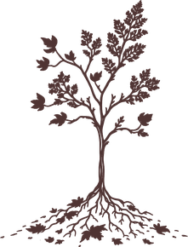
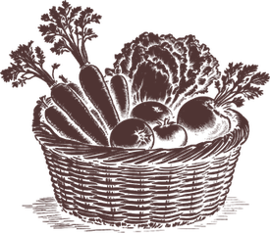

From soil to plate
→
→
Living
soil
Healthy
plant
Nutritious
food
Carla explains how soil biology
shapes the nutrients in our food

Slide 5

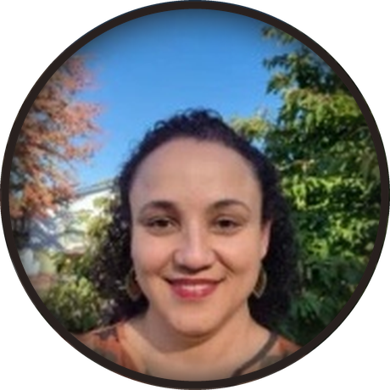

Watch Carla live
Sunday 15 November, 7 to 7:45am Pacific
Food as Medicine for All · Livestream
Link in bio

