Slide 1

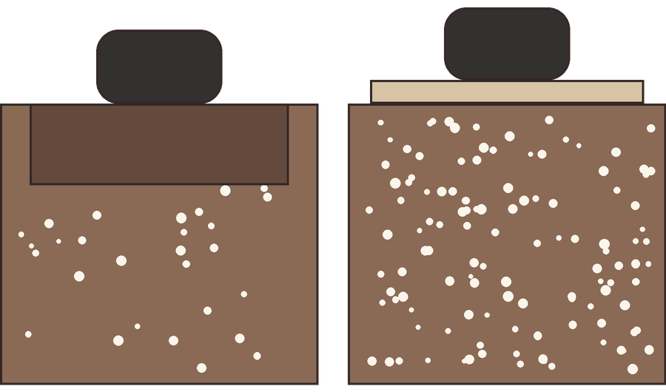

DO THIS WEEKEND
Stay off wet beds.
Wet soil under a boot: pores pressed shut.
A board spreads the weight: the crumb stays open.
Walk on boards or a mulched path instead.

