Slide 1

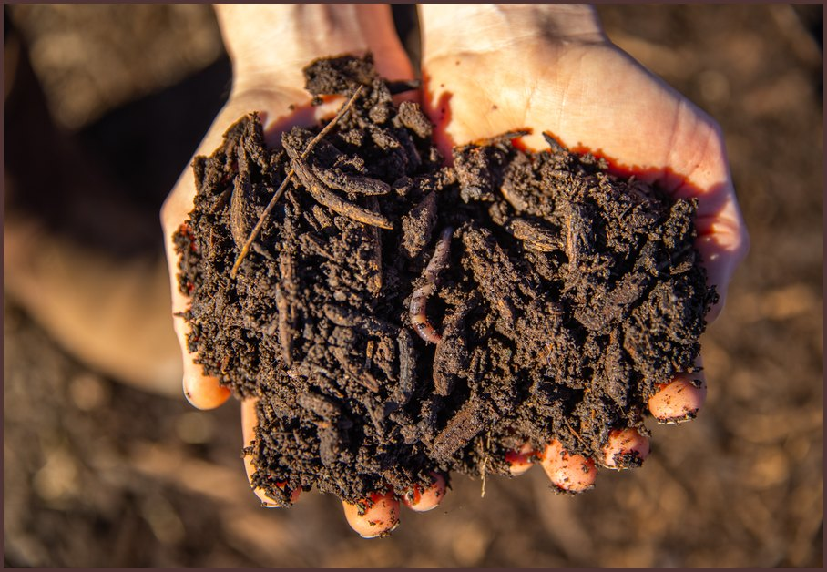

COMPOST INTENSIVE COURSE
The January cohort starts this month.
Link in bio.
Photo: Soil Food Web Foundation

