Slide 1

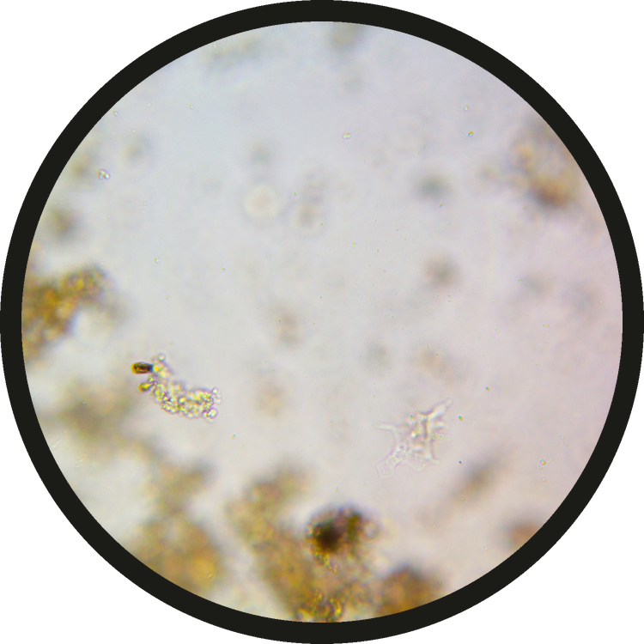

READ THE DROP
Meet the naked amoeba.
NAKED AMOEBA, 40X OBJECTIVE
Micrograph: Jimena Fuentes

Slide 2

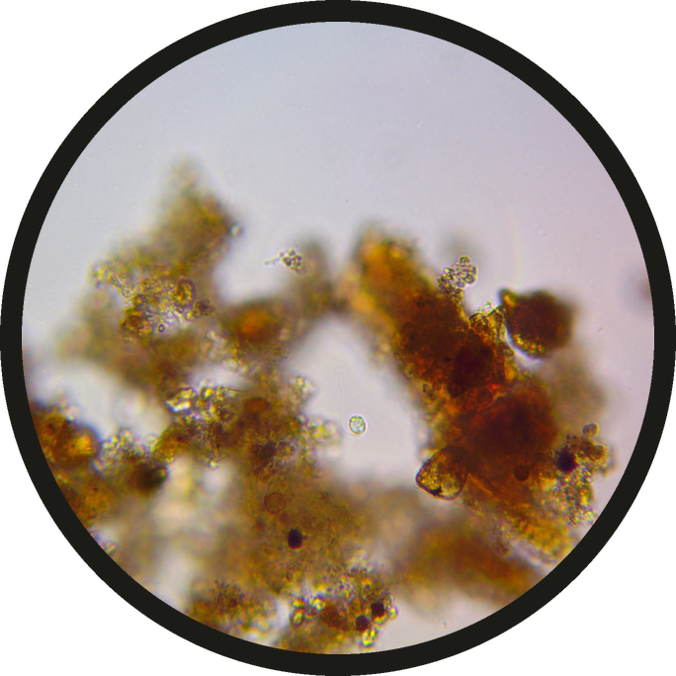
It eats bacteria and releases ammonium by the roots.
Micrograph: Jimena Fuentes

