Slide 1

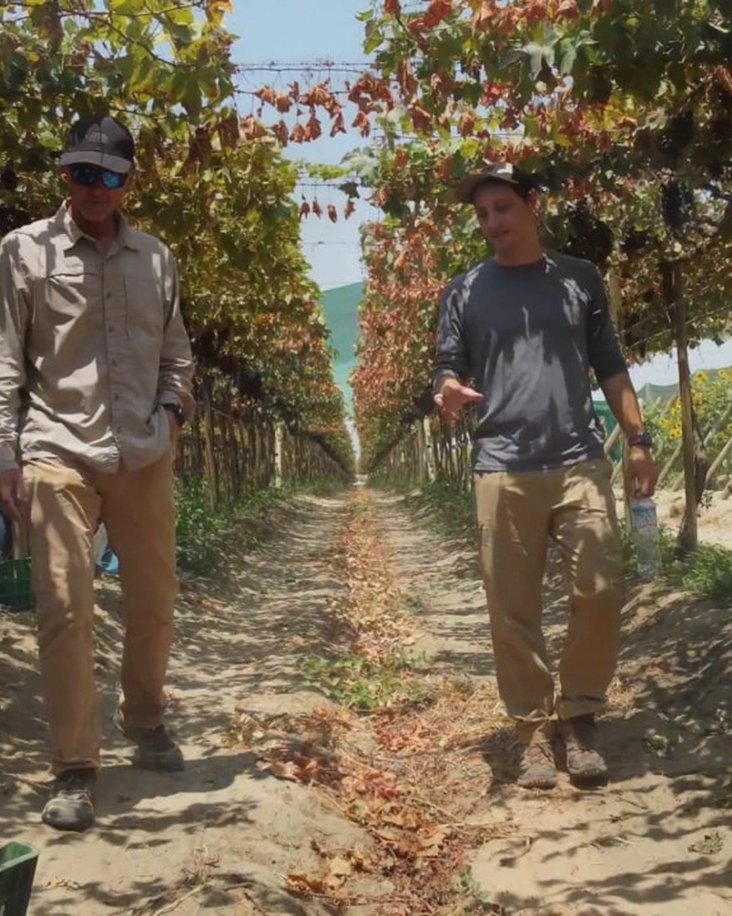


SOIL REGENERATORS IN THE WILD
Roberto Silva and consultant Miles Sorel
Piura, Peru
Still: Roberto Silva case study film

