Slide 1

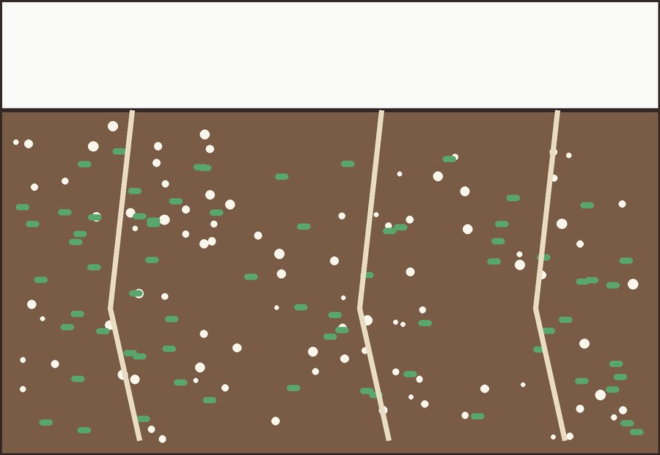

MYTH VS MECHANISM
Myth: soil life sleeps all winter.
SNOW

Slide 2

THE MECHANISM
Under the snow, microbes keep growing.
bacteria still dividing around the roots

