Slide 1

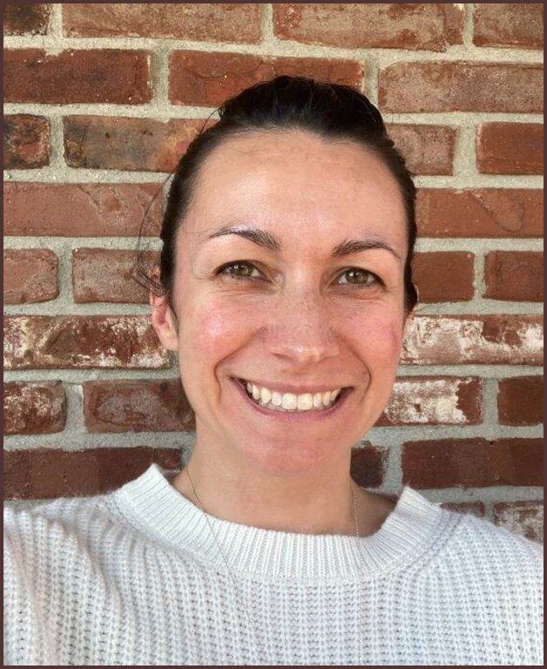

MEET THE TEAM
Stephanie McDaniel
Director of Communications
Photo: Soil Food Web Foundation

