Slide 1

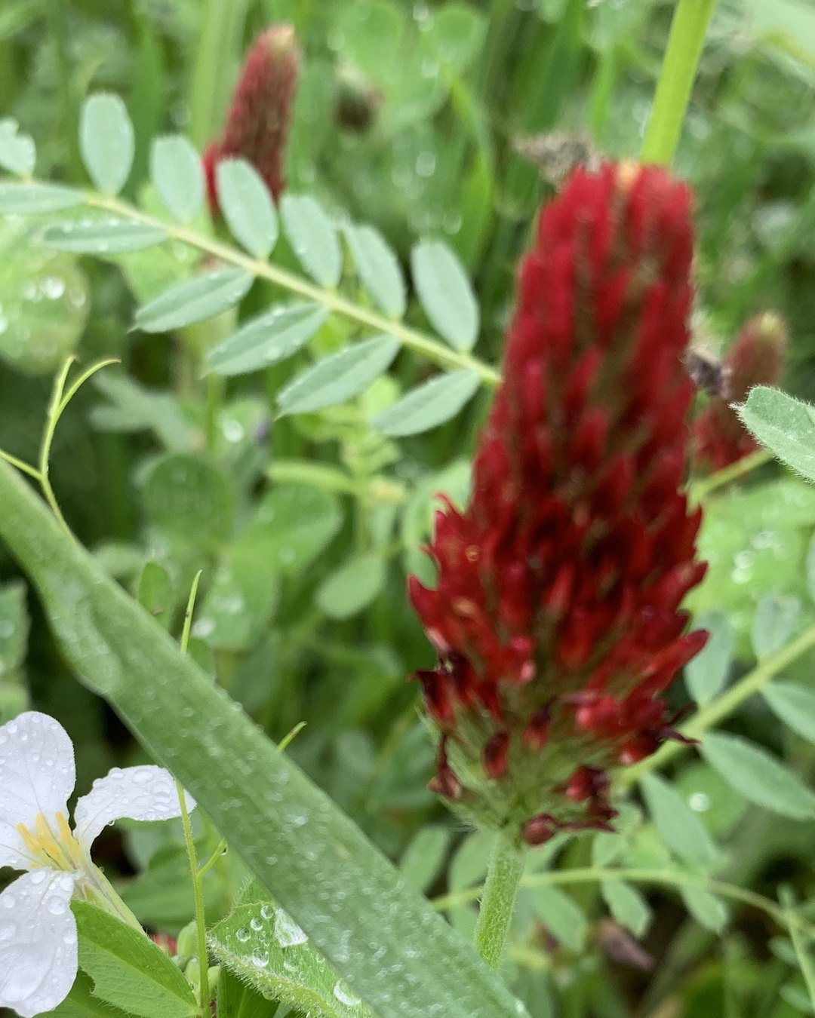


DO THIS WEEKEND
Plan your cover crops.
Legumes add nitrogen. Grasses hold on to it. Mix both.
Photo: Soil Food Web Foundation (crimson clover)

