Slide 1

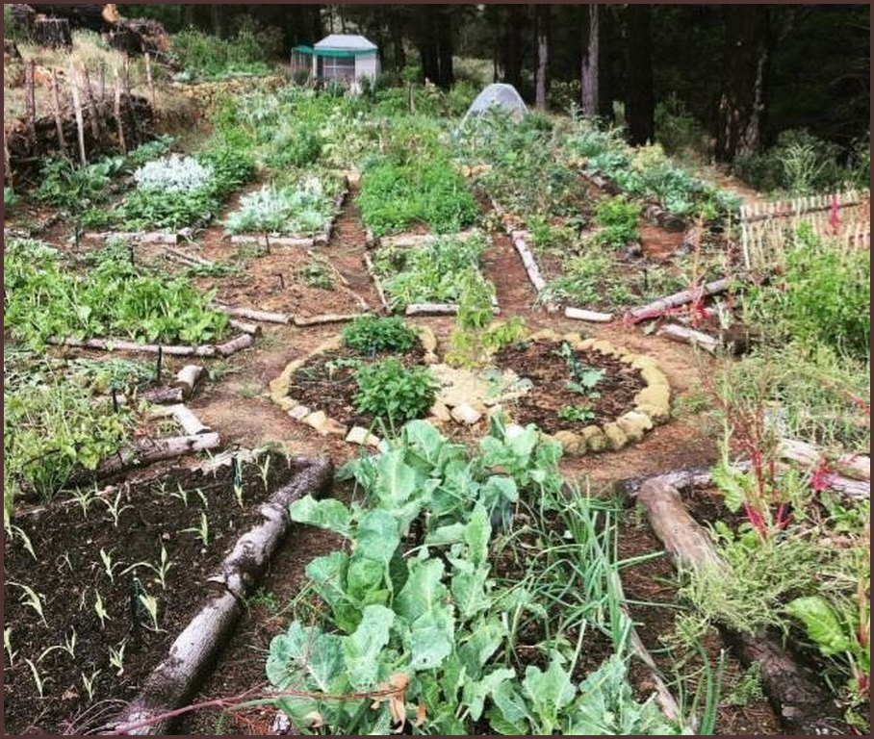

PERMACULTURE PRINCIPLE 1
Observe and interact.
Watch first, then design.
Photo: Soil Food Web Foundation (Panchamana, Ecosystem Restoration Camps)

