Slide 1

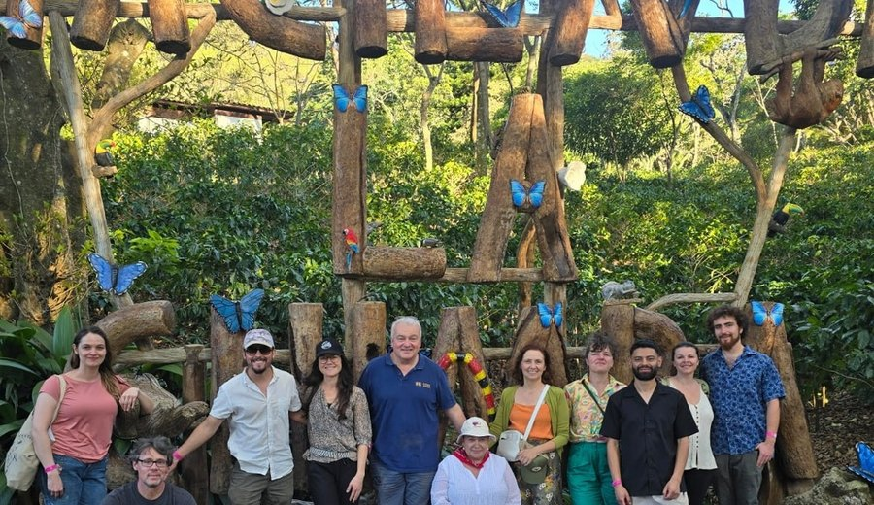
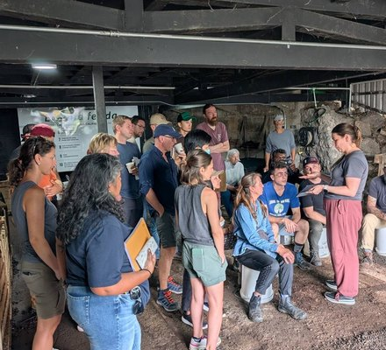
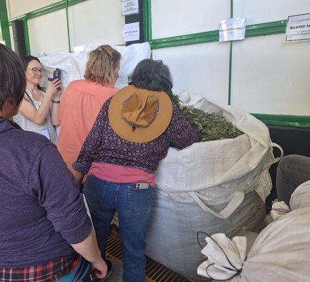

One week to go.
Accelerator Workshop, Costa Rica, 18 to 29 January at Armonía.
Photo: Soil Food Web Foundation (Costa Rica, 2025)

