Slide 1

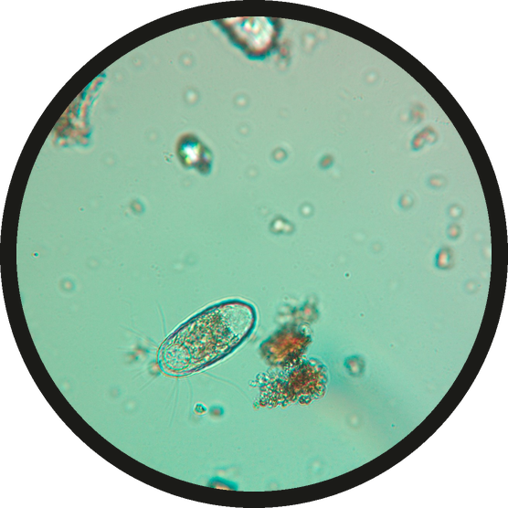

SOIL IN NUMBERS
1,000,000
protozoa can live in one teaspoon of highly fertile soil. Poor soil holds about 1,000.
Source: USDA NRCS Soil Biology Primer. Micrograph: Cameron Radman

