Slide 1

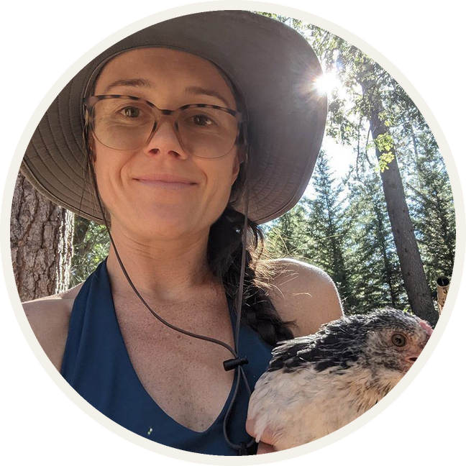

MEET THE TEAM
Sammie Bass
MARKETING ASSOCIATE
Photo: Soil Food Web Foundation

