Slide 1

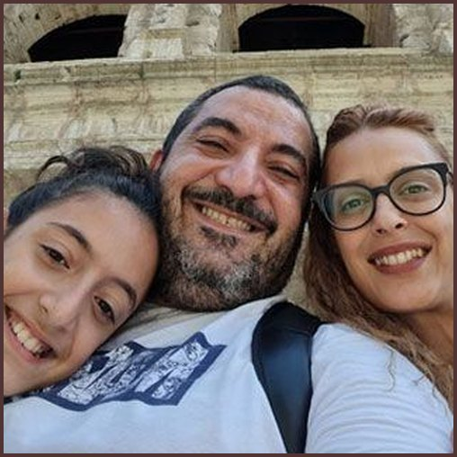

MEET THE TEAM
Alex Andreou
IT Manager
Photo: Soil Food Web Foundation

