Slide 1

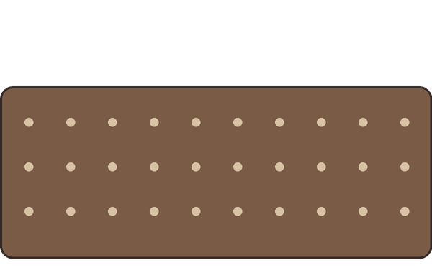

1
Sow 100 radish or cress seeds in moist compost.

Slide 2

2
Keep it moist and in the light for 5 to 10 days.
Method: Institute for Local Self-Reliance, germination test

Slide 3

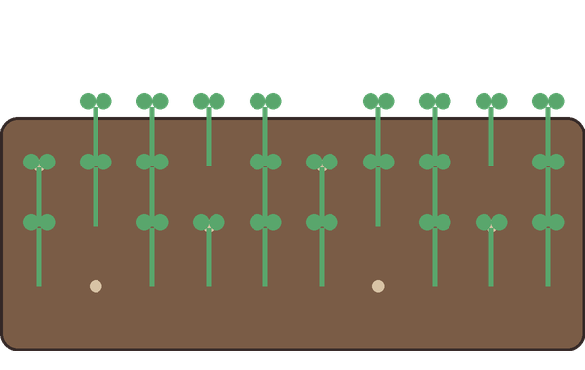
3
80 or more sprouts: the compost is likely mature.

