Slide 1

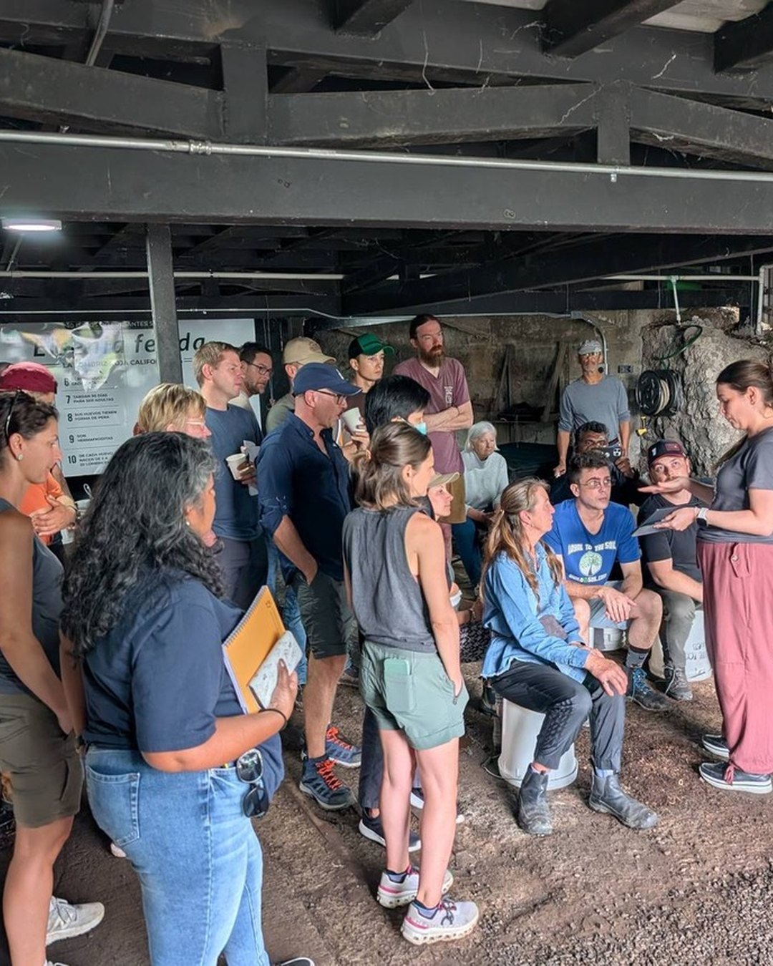


ACCELERATOR WORKSHOP, COSTA RICA
Tomorrow we start.
Week one: compost. Week two: biological liquid amendments.
Photo: Soil Food Web Foundation (Costa Rica, 2025)

