Slide 1

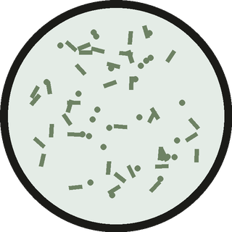
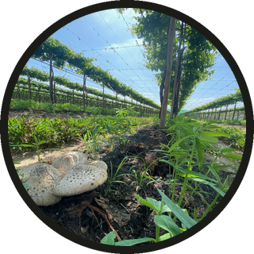
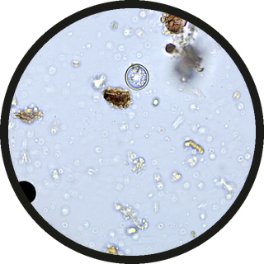
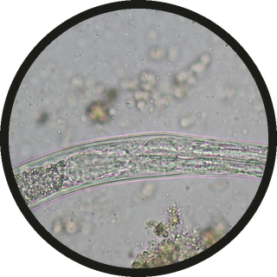

FOUNDATION COURSES
Learn to identify the four groups.
BACTERIA (DRAWN)
FUNGI
PROTOZOA
NEMATODES
Start any time. Link in bio.
Micrographs: SFW library, Tanja Dekker, Johannes Veith. Bacteria drawn.

