Slide 1

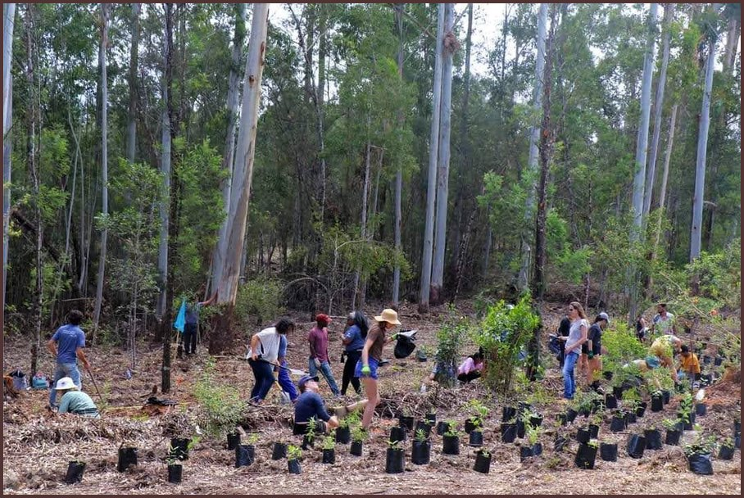

NEW COURSE
Intro to Permaculture opens 1 February.
Photo: Soil Food Web Foundation (Panchamana, Ecosystem Restoration Camps)

