Slide 1

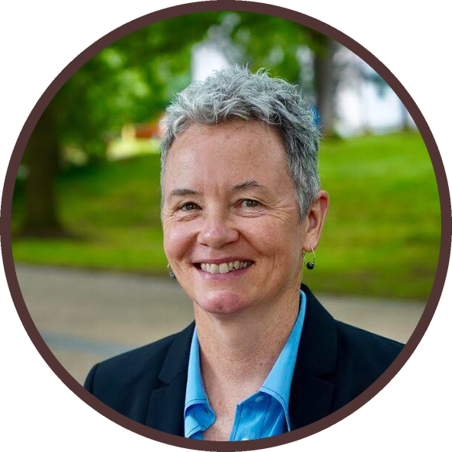

MEET THE TEAM
Leslie W. Lewis, Ph.D.
EXECUTIVE COMMITTEE
Photo: Soil Food Web Foundation

