Slide 1


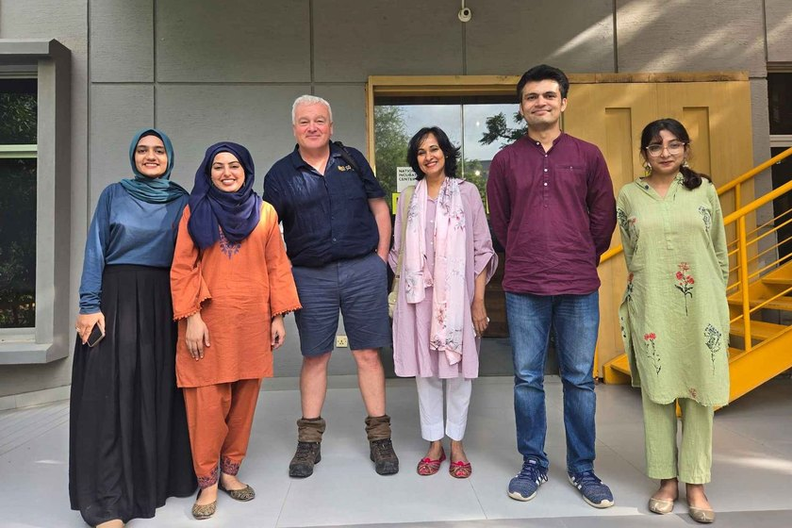

SOIL REGENERATORS IN THE WILD
TrashIt, Pakistan
Soil Health Week 2025
Photo: Soil Food Web Foundation

