Slide 1

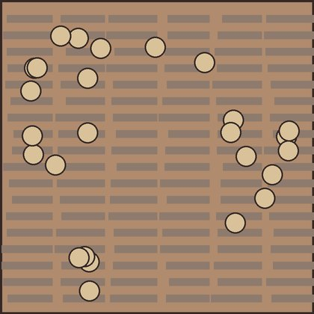

MYTH VS MECHANISM
Myth: add sand to loosen clay soil.
Sand in clay packs tight and can set hard.

Slide 2

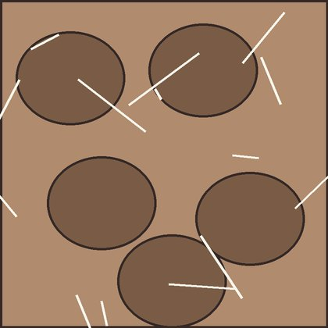
THE MECHANISM
Add organic matter and let soil life build the crumb.
Fungal threads and microbial glues hold crumbs together, with air and water between.

