Slide 1

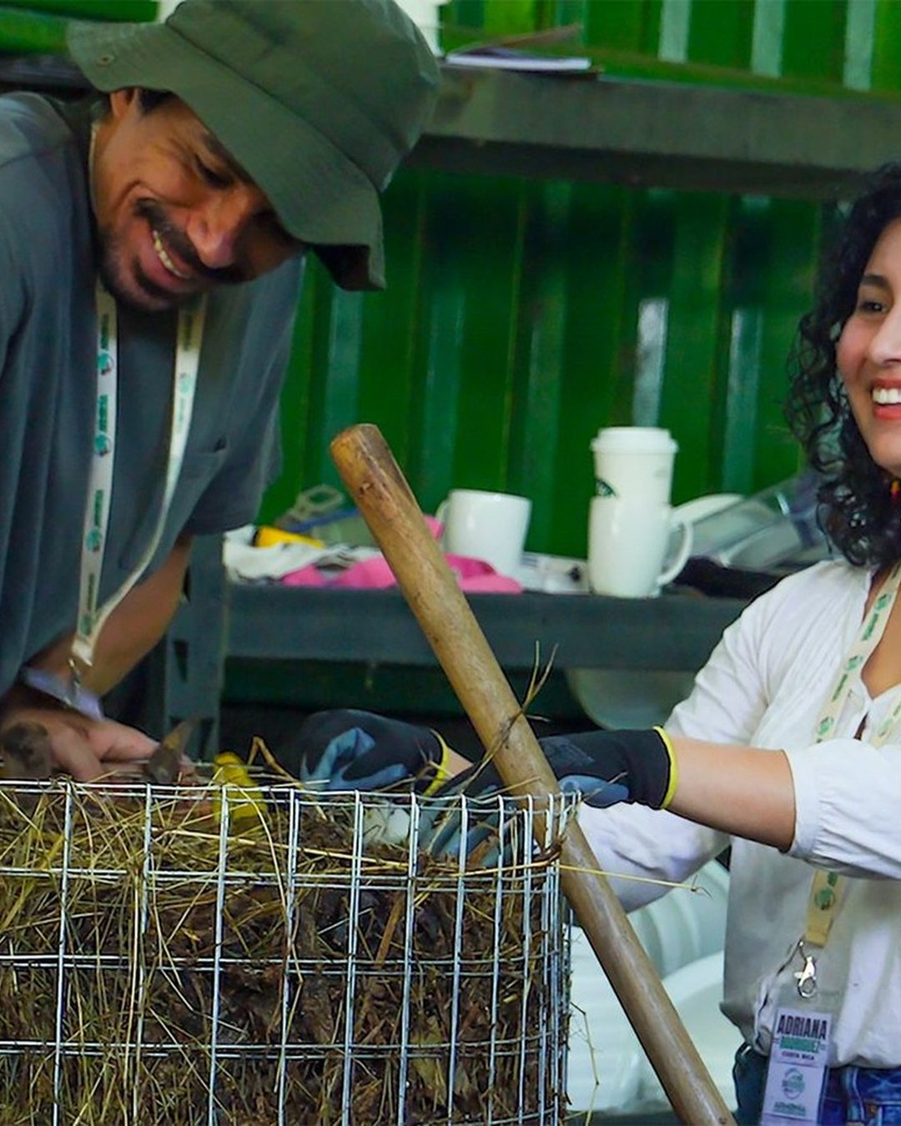


LIVE FROM COSTA RICA
Building the piles.
Photo: Soil Food Web Foundation (Costa Rica, 2025)

