Slide 1

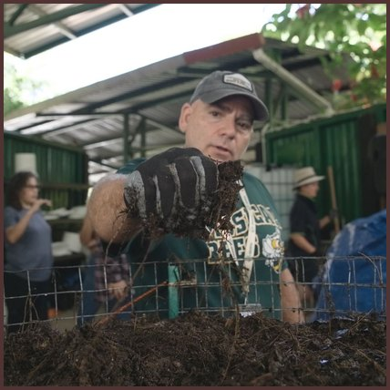

1
Reach into the pile and squeeze a handful tight.
Photo: Soil Food Web Foundation

Slide 2

2
A wet sheen and no drips: right where you want it.

Slide 3

3
Drips mean too wet. Dry and dusty means too dry.
Source: LSU AgCenter, Compost Moisture Content

