Slide 1

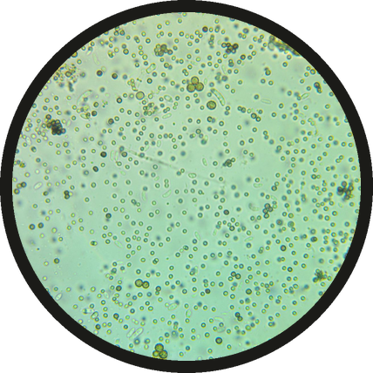
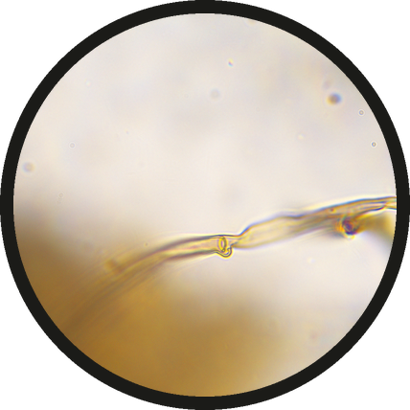

READ THE DROP
Spores or hyphae?
SPORES: FUNGI ON PAUSE
HYPHAE: FUNGI AT WORK
Micrographs: SFW library, Marco Trevisan

Slide 2


Hyphae on your slide mean fungi growing and working now.
Micrographs: SFW library, Marco Trevisan

