Slide 1

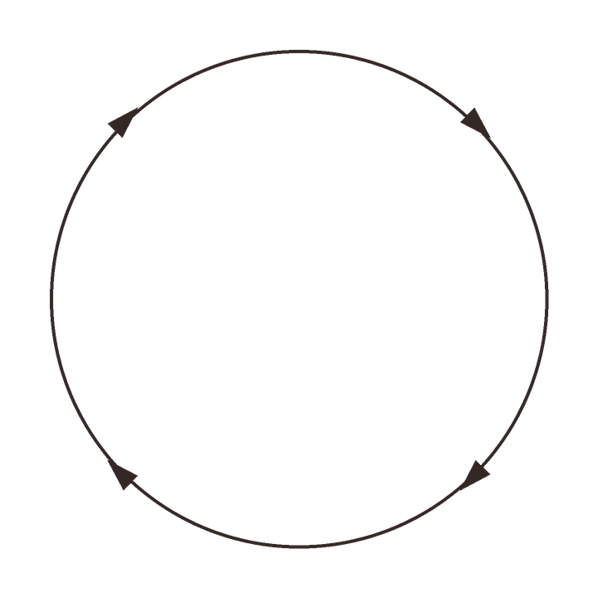





PERMACULTURE PRINCIPLE 6
Produce no waste.
PRUNINGS
PLANTS
MULCH
LIVING SOIL
Prunings become mulch, scraps become compost.

