Slide 1

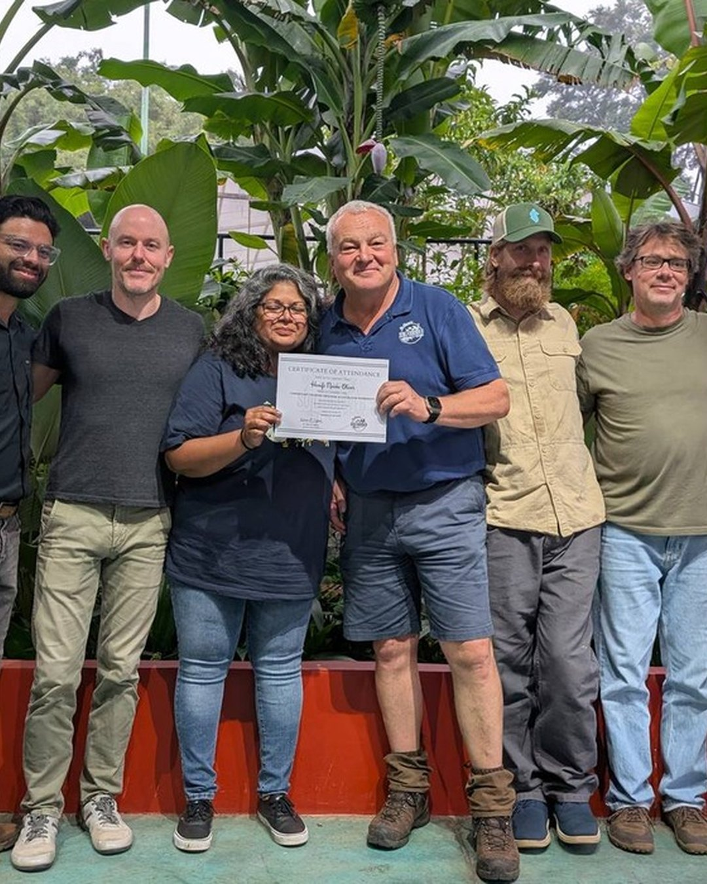


COSTA RICA, JANUARY 2027
Thank you, Costa Rica, and thank you, Armonía.
Photo: Soil Food Web Foundation (Costa Rica, 2025)

