Slide 1

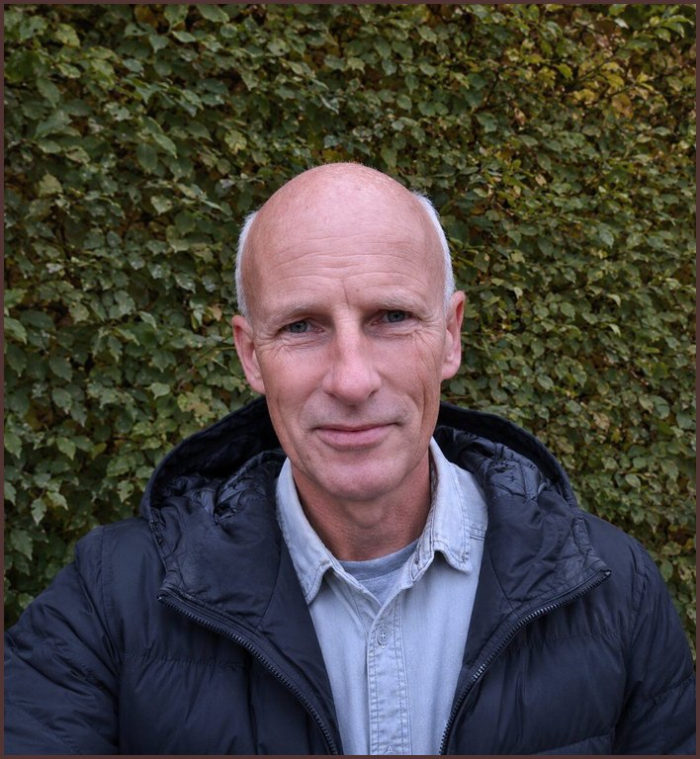

MEET THE TEAM
Ib Borup Pedersen
Farmer, Soil Food Web Consultant and mentor
Photo: Soil Food Web Foundation

