Slide 1


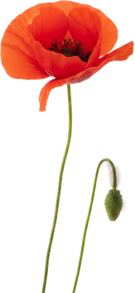





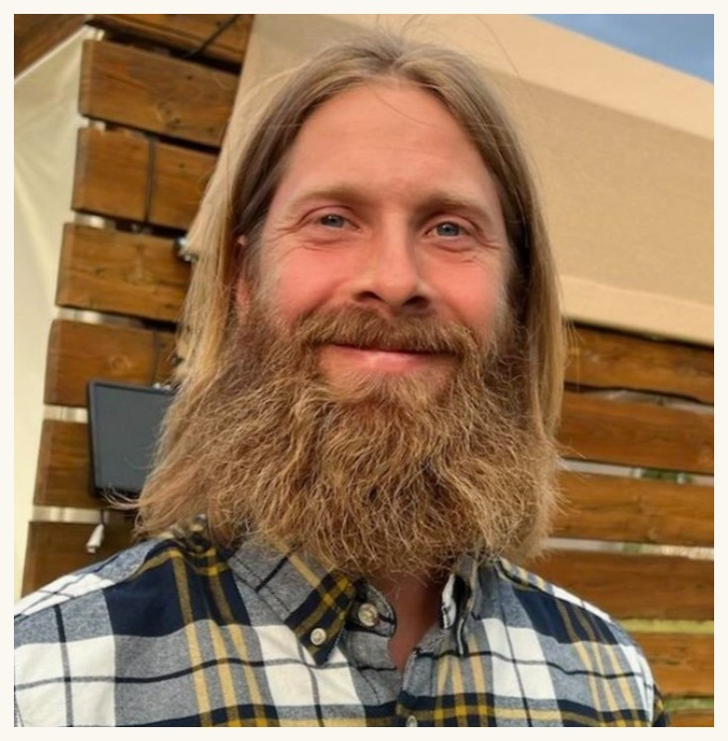
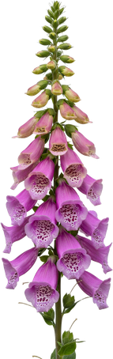









Casey Williams
Soil Food Web mentor
Notes:
Casey Williams, Soil Food Web mentor. Flower frame from Linnea's Canva deck.

Slide 2
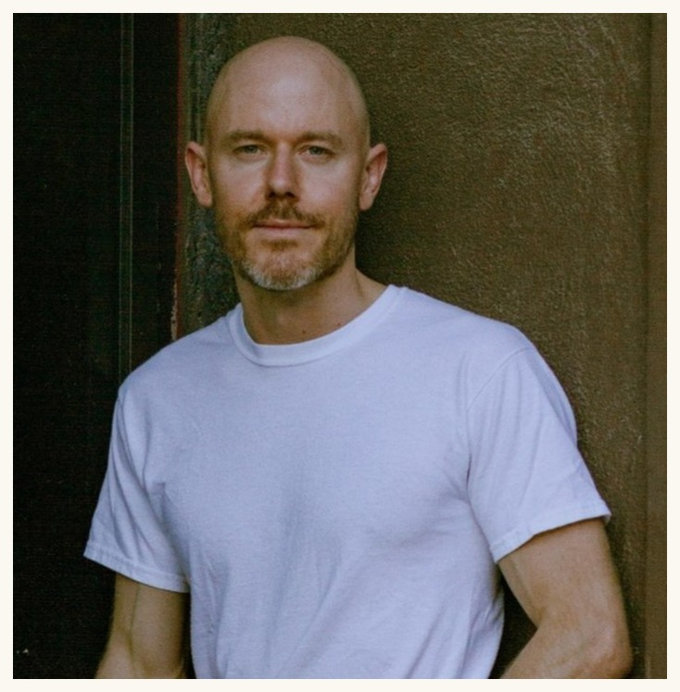
Brian Daubenspeck
Soil Food Web mentor
Notes:
Brian Daubenspeck, Soil Food Web mentor. Flower frame from Linnea's Canva deck.

Slide 3
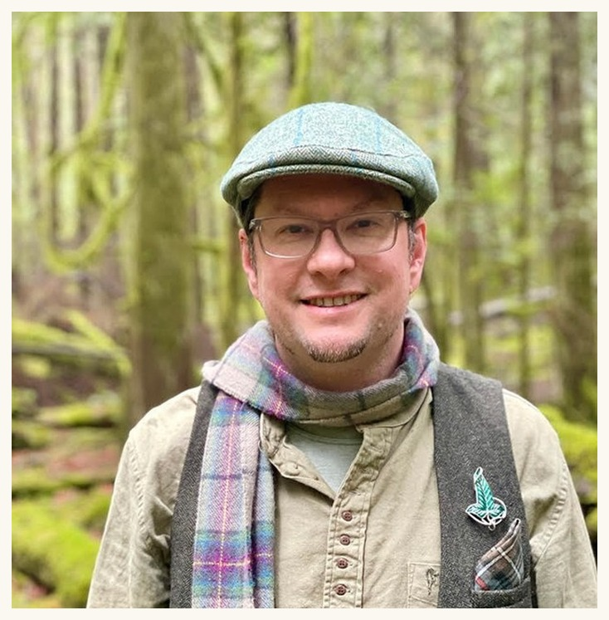
Delvin Solkinson
Permaculture Lead
Notes:
Delvin Solkinson, Permaculture Lead. Flower frame from Linnea's Canva deck.

Slide 4
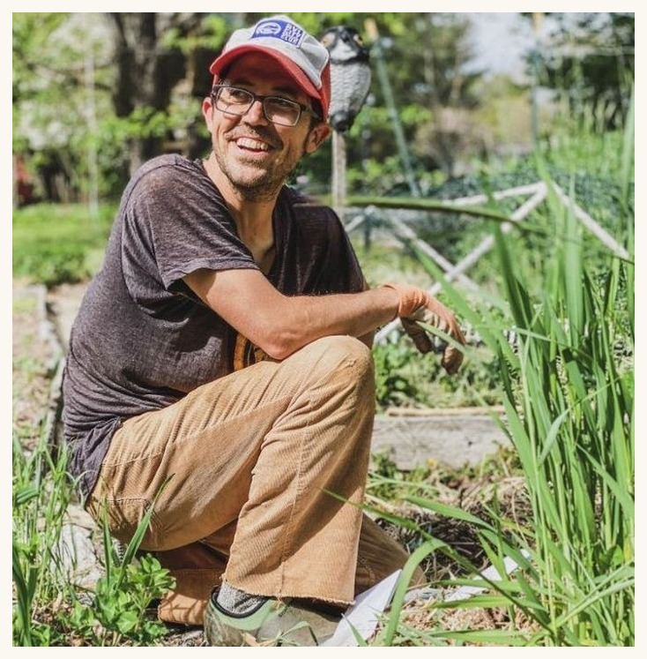
Tommy Tepper
Director of Education
Notes:
Tommy Tepper, Director of Education. Flower frame from Linnea's Canva deck.

Slide 5
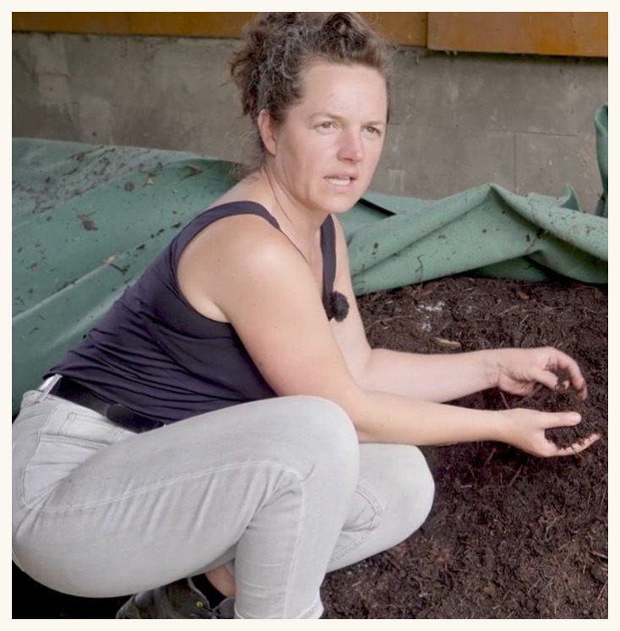
Dora Tkalec
Soil Food Web mentor
Notes:
Dora Tkalec, Soil Food Web mentor. Flower frame from Linnea's Canva deck.

