Slide 1







Foundation Courses + Compost Intensive
Fall Enrollment Special
Until 2 December.

Slide 2


Dr. Elaine's decades of knowledge, in one easy-to-follow online course
Four Foundation Courses. Self-paced, start the day you enroll.

Slide 3

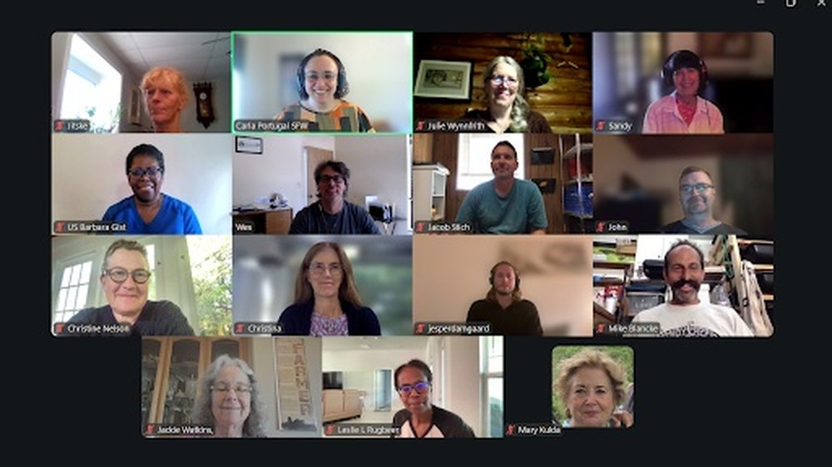
The Compost Intensive Course
Live with a mentor every week, alongside a global cohort of peers.

Slide 4


Join our student community
A community for Foundation Courses students, and your own Compost Intensive cohort.

Slide 5


Hundreds of hours of FC webinars
Dr. Elaine and others go deeper into the Foundation Courses and more, to deepen your learning and put it into action.

Slide 6

Over
50% off
Foundation Courses + Compost Intensive
Fall Enrollment Special
Until 2 December.

Slide 7


Foundation Courses + Compost Intensive
Fall Enrollment Special
Until 2 December.

