Slide 1
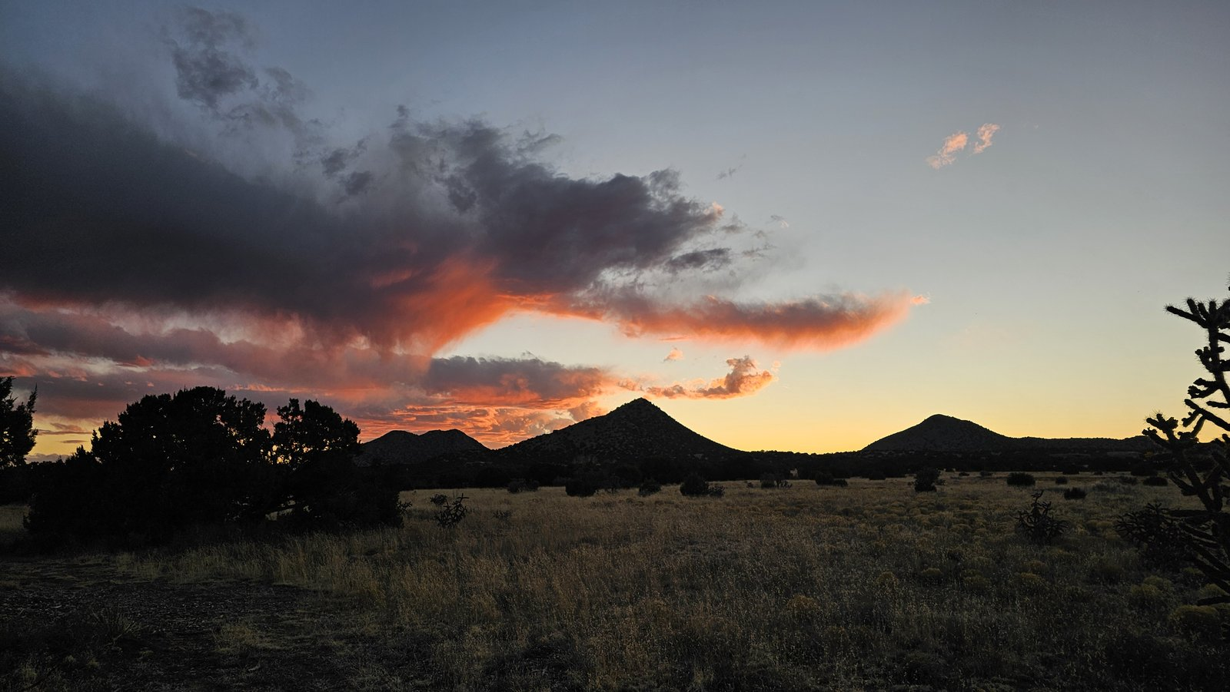

Accelerator Workshop, New Mexico
3 to 14 May 2027

Slide 2
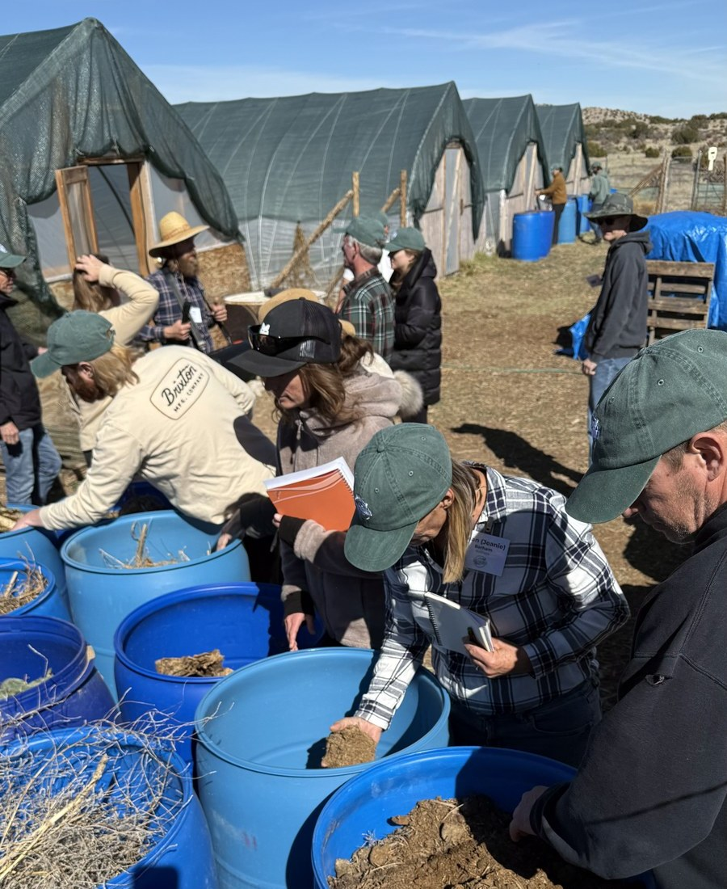
Students build compost from local feedstocks.
Wood chips, alfalfa and hay from the high desert.

Slide 3
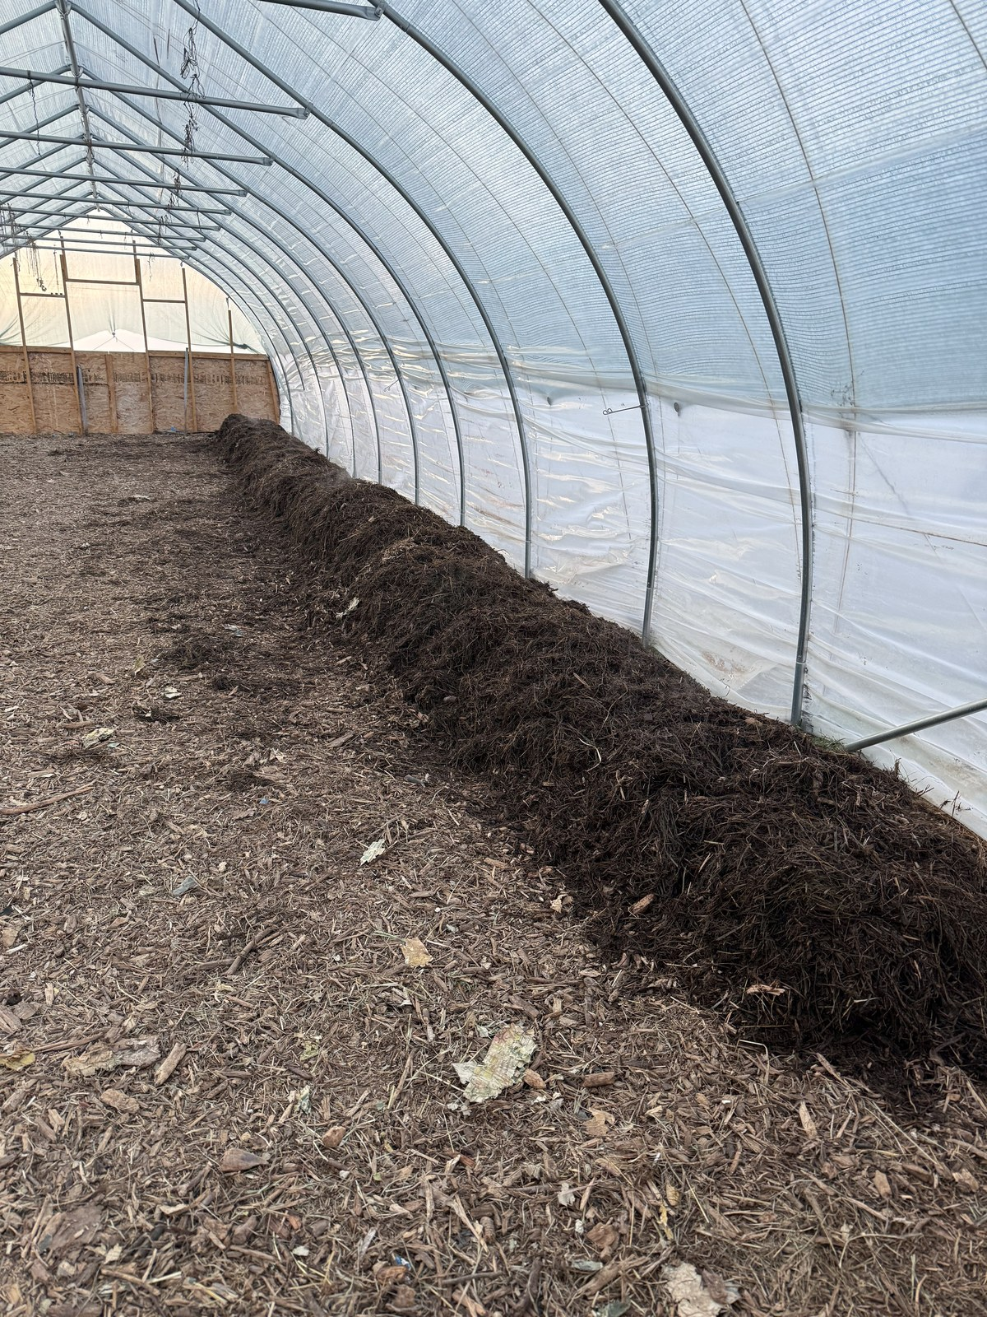
Then they watch the compost come alive.
In the hoop houses at Synergia Ranch.

Slide 4
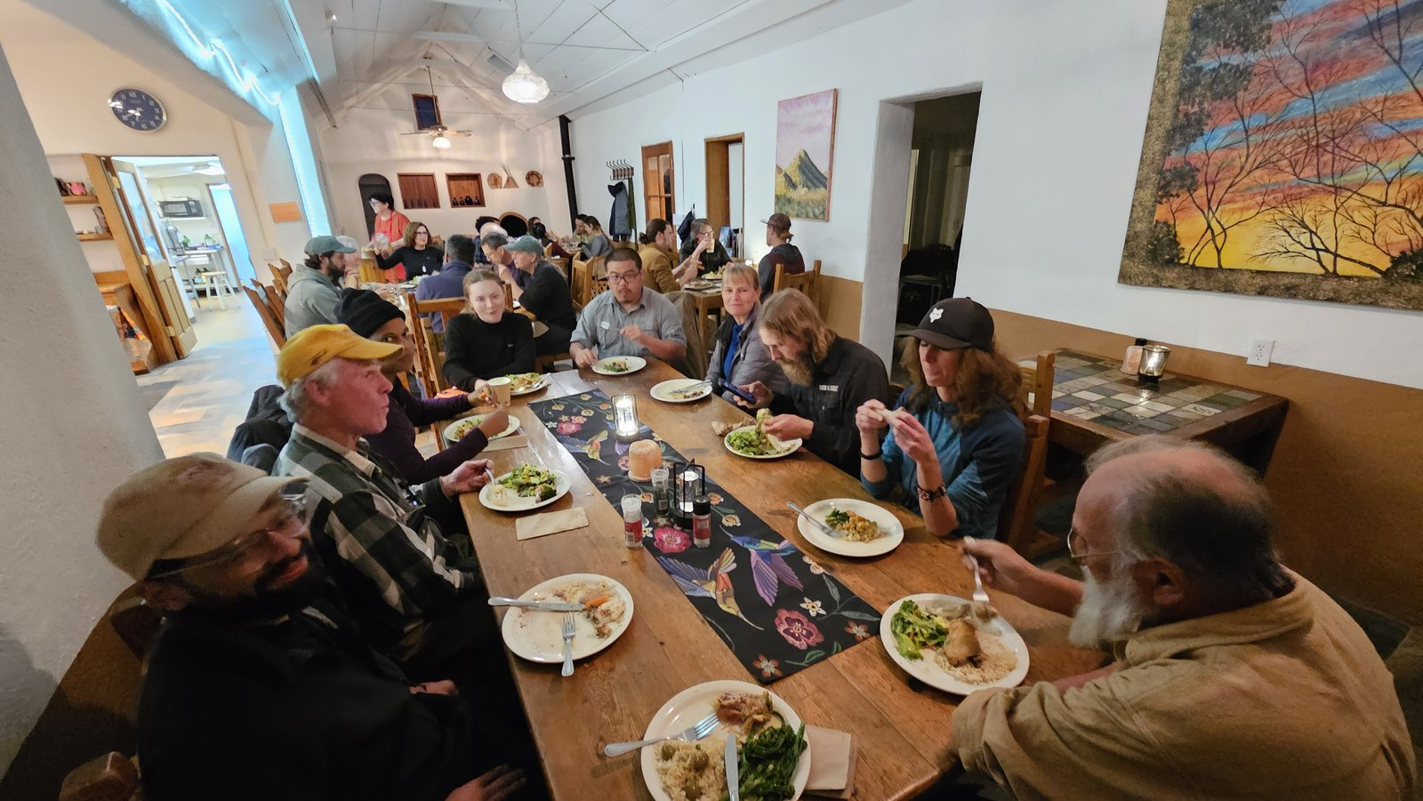
And they share every meal together.
Our February 2026 workshop, near Santa Fe.

Slide 5
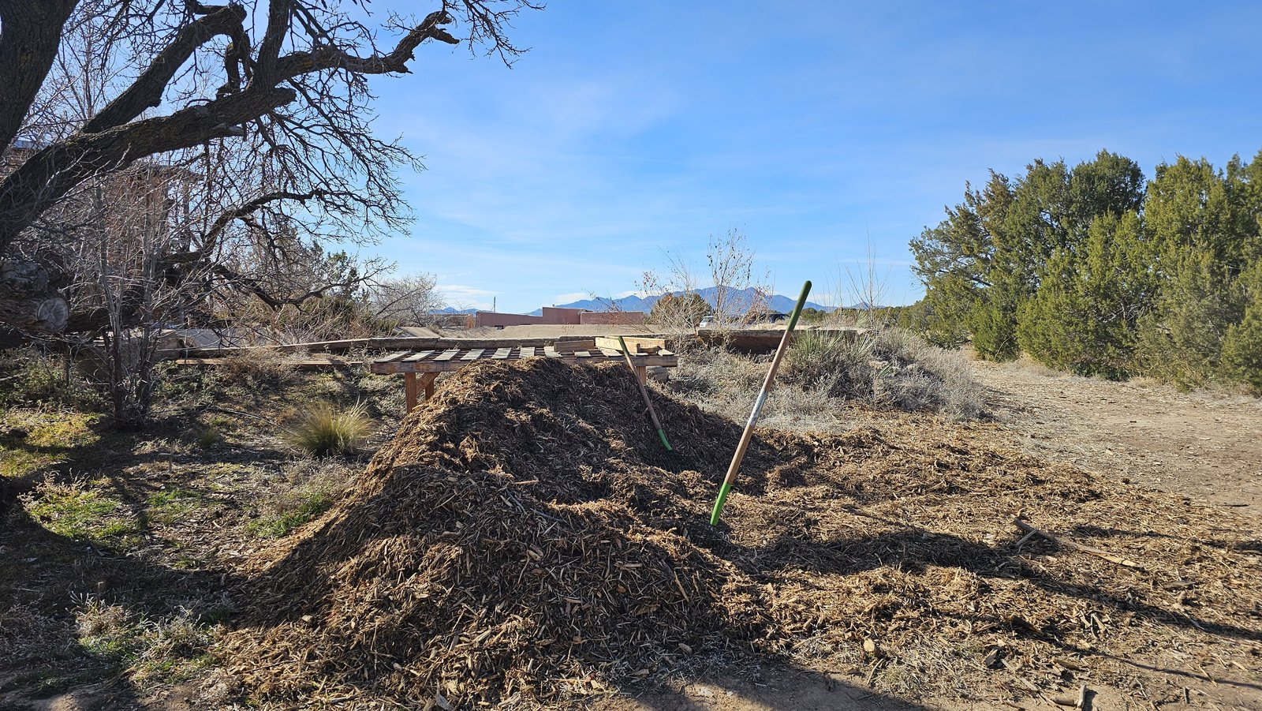
3 to 14 May 2027
Accelerator Workshop at Synergia Ranch, near Santa Fe, New Mexico
Register your interest, link in bio

